Slide 1

Hunting SMB Shares
With Data, Graphs, Charts, and LLMS
Scott Sutherland

Slide 2






Scott Sutherland
(nullbind)
VP of Research at NetSPI
Service & Product Development
Find, exploit, and detect things that go boom on your network
GitHub Projects github.com/netspi/PowerHuntShares
/PowerUpSQL
/DAFT
/SQLC2
/PowerHunt
/PowerShell/Crypt-It
Blogs
https://www.netspi.com/authors/scott-sutherland/
GitHub: nullbind
X: @_nullbind
Bsky: @nullbind.bsky.social
Notes:
I’ve been pentester, red teamer, or purple teamer for the better part of the last 20 years.
Like most people in the industry, my completely unbiased opinion is that to build a strong defense you need to build a strong offense. Which we have seen in evolve in the last decade.
While I still whole heartedly believe in that approach, in recent years I’ve also tried to focus on bettering understanding how and why issues are introduced into environments in the first place.
So now my longer-term goal is trying to remediate issues more effectively and possibly predicting likely future areas of exposure and risk.
To do that I decided to turn to more traditional data science and start with a topic I’m familiar with, excessive privileges.
Today we will be exploring that area through the lens of smb shares.

Slide 3

Two Parts One Story
A legacy of excessive privileges.
Hunting for context in a sea of share data.
Notes:
Understanding the problem has always been an important part of findings solutions for me so we are going to start story about how we go here
Then we will explore what PowerHuntShares is, how the v2 version works under the hood, and cover some of the features/analysis techniques still in development.

Slide 4
Story Time
A legacy of excessive privileges.

Slide 5

Story Time
Notes:
Just starting out.

Slide 6

Story Time
Notes:
All alone with my own documents.

Slide 7



Story Time
Notes:
Someone creates a share on their own system to centralize documents.

Slide 8






Story Time
Notes:
New devops spins up their own database server with a wide-open backup folders that stored all their database back ups.

Slide 9

Story Time
Notes:
The problem is many of the shares were configured with excessive privileges because they lacked an understanding of security, they followed insecure vendor installation guides, or because they just wanted to make their lives easy.
The result…

Slide 10




Story Time
Notes:
A ransomware threat actors opportunistically targets them because one of their web servers suffered from a zero day being used in a campaign.

Slide 11

Story Time
Notes:
They pay the ransom because they can't afford not to, they then clean up the environment and get back to normal.

Slide 12
+
+
+
Notes:
Then they bought another company, and another, and another. Now they have inherited the same old set of problems.

Slide 13
This is a reality that a lot of businesses are trying to manage. Still.

Slide 14
What’s broken, why are we missing so much now?

Slide 15
What’s broken, why are we missing so much now?
Incomplete inventory
Insufficient vulnerability scanning
Privilege inheritance and nested groups
Generally understanding share context
Managing permissions at scale is hard!

Slide 16
So How do SMB Share Permissions Work?
Notes:
Managing share permissions is hard at scale. So, let’s take a moment to talk about how they work.

Slide 17



NTFS & Share Permission Most Restrictive Wins
Share
NTFS
John
Share Permissions
John: Read Sue: Write Kevin: Full Control
NTFS Permissions
John: Full Control Sue: Change Kevin: Read
Notes:
Leave privileges wins.

Slide 18
NTFS & Share Permission Most Restrictive Wins
Share
NTFS
Kevin
Share Permissions
John: Read Sue: Write Kevin: Full Control
NTFS Permissions
John: Full Control Sue: Change Kevin: Read
Notes:
Leave privileges wins again!

Slide 19



Default Inherited Permissions Are. The. Worst. …Best?
NTFS
Share
Logon.bat
Local Users
Everyone: Read
Builtin\User: write
Builtin\Users: Write
Authenticated Users
Domain Users
Domain Users
Domain Computers
Domain Computers
Notes:
Let’s talk about when least privilege aren’t what they seem.
Local file containing a script you want everyone to run.
You create a share and allow everyone read access.
Builtin\User - When a system is not joined to the domain, it doesn’t do much in the way of influencing access.
Builtin\User - When a system is joined to an Active Directory domain, Authenticated Users implicitly includes the “Domain Users” and “Domain Computers” groups.
For example, an IT administrator may think they’re only providing remote share access to the Builtin\Users group, when in fact they are giving it to everyone on the domain.
The lesson here is that a small misunderstanding around local and domain group relationships can lead to unauthorized access and potential risk.

Slide 20
What’s the impact, what can attackers do?
Read data they shouldn’t be able to
Write, Modify, Delete data they shouldn’t be able to
Execute Code Remotely…
Notes:
Let’s talk about a couple RCE scenarios and see what those look like.

Slide 21







Attacking Shares Read Access.
SQL
PW
Download
Password File
www
Attacker
Compromised
Domain User
Web Server
Login & RCE
Database Server
Notes:
Attacker gets access to the environment.
Attacker Compromises a domain user or computer.
Attacker reads web.config from web root that contains SQL Server credentials.
Attacker uses SQL Server sa credentials to log into the SQL Server and execute code as the SQL Server service account.

Slide 22

Attacking Shares Write Access.
File.dll
Write file
Application DLL Hijacking
Application Domain Hijacking
Modify Service Binaries
Modify Scheduled Task Files
Modify All Users Startup
Web Shells
C$
SVC
Attacker
Compromised
Domain User
Web Server
Call Back to Attacker
(or whatever)
Notes:
Attacker gets access to the environment.
Attacker compromises a domain user or computer.
Attack finds system that provides Domain Users write permissions to C$.
Attacker uploads a file to the C$.
Depending on technique, the code/file gets executed in the context of an elevated service account.

Slide 23
Shares are one of the
MOST abused attack surfaces but require the
LEAST amount of knowledge to attack

Slide 24
How do we determine
which share exposures represent actual risk?
Notes:
The short answer is data analysis!

Slide 25

SO-CON
How do we prioritize remediation of
100,000 or more shares?
Common
Data Analysis
Techniques

Slide 26
Hunting for context in a sea of share data
…while building PowerHuntShares v2

Slide 27
What is PowerHuntShares?
https://github.com/NetSPI/PowerHuntShares
“PowerHuntShares is PowerShell tool designed to help cybersecurity teams and penetration testers better identify, understand, attack, and remediate SMB shares in the Active Directory environments they protect.”
Key Features
Find Shares with Excessive Privileges
Find RCE
Find Data Exposures
Find & Extract Secrets
Add context through data enrichment
Gain insights to prioritize and drive action!
Notes:
Today we’ll coverage some of the new thing that I worked on in PowerHuntShares v2.

Slide 28
PowerHuntShares Process
Define
Goals
Collect
Data
Clean
Data
Transform
Data
Analyze
Data
Extract Insights & Predictions
Conclusions, Findings
& Recommendations
Take
Actions
https://github.com/NetSPI/PowerHuntShares

Slide 29

PowerHuntShares Process
Define
Goals
Collect
Data
Clean
Data
Transform
Data
Analyze
Data
Extract Insights & Predictions
Conclusions, Findings
& Recommendations
Take
Actions
“Alice created the ‘MyApp$’ share on 200 systems to support the SuperPOS3k application on 4/1/2025. The shares were configured excessive read/write privileges which exposed sensitive data and provided a means to execute remote code.”
Notes:
This is the only thing I set out to do in PowerHuntShare v2, but that was a more interesting journey than I thought it would be.

Slide 30
PowerHuntShares Process
Define
Goals
Collect
Data
Clean
Data
Transform
Data
Analyze
Data
Extract Insights & Predictions
Conclusions, Findings
& Recommendations
Take
Actions
Goals: Who, What, When, Where, Why, How
What Happened? Descriptive Analysis
Why did it happen?
Diagnostic Analysis
What will happen?
Predictive Analysis
What should I do?
Prescriptive Analysis
https://github.com/NetSPI/PowerHuntShares
Notes:
Consolidate remediations
Prioritize remediations

Slide 31

PowerHuntShares Process
Define
Goals
Collect
Data
Clean
Data
Transform
Data
Analyze
Data
Extract Insights & Predictions
Conclusions, Findings
& Recommendations
Take
Actions
Data Collection
Asset Coverage Active directory query + port connectivity tests + optional ping test
Data Visibility Names, dates creation, last modified, and last accessed dates
Directory listings, hashes of directory listings, file counts
https://github.com/NetSPI/PowerHuntShares
Notes:
Do I have the data I need to answer my questions?
The collection process was pretty basic and essentially a wrapper around a few lightly modified PowerView.

Slide 32
Bypass. Download. Run.
https://github.com/NetSPI/powerhuntshares
# Bypass execution policy restrictions
Set-ExecutionPolicy -Scope Process Bypass
# Import module that exists in the current directory
Import-Module .\PowerHuntShares.psm1
or
# Reduce SSL operating level to support connection to github
[System.Net.ServicePointManager]::ServerCertificateValidationCallback = {$true}
[Net.ServicePointManager]::SecurityProtocol =[Net.SecurityProtocolType]::Tls12
# Download and load PowerHuntShares.psm1 into memory
IEX(New-Object System.Net.WebClient).DownloadString("https://raw.githubusercontent.com/NetSPI/PowerHuntShares/main/PowerHuntShares.psm1")
https://github.com/NetSPI/PowerHuntShares
Notes:
Setup

Slide 33
Discovery Output
https://github.com/NetSPI/powerhuntshares
---------------------------------------------------------------
SHARE DISCOVERY
---------------------------------------------------------------
[*][03/01/2021 09:35] Scan Start
[*][03/01/2021 09:35] Output Directory: c:\temp\smbshares\SmbShareHunt-03012021093504
[*][03/01/2021 09:35] Successful connection to domain controller: dc1.demo.local
[*][03/01/2021 09:35] Performing LDAP query for computers associated with the demo.local domain
[*][03/01/2021 09:35] - 245 computers found
[*][03/01/2021 09:35] Pinging 245 computers
[*][03/01/2021 09:35] - 55 computers responded to ping requests.
[*][03/01/2021 09:35] Checking if TCP Port 445 is open on 55 computers
[*][03/01/2021 09:36] - 49 computers have TCP port 445 open.
[*][03/01/2021 09:36] Getting a list of SMB shares from 49 computers
[*][03/01/2021 09:36] - 217 SMB shares were found.
[*][03/01/2021 09:36] Getting share permissions from 217 SMB shares
[*][03/01/2021 09:37] - 374 share permissions were enumerated.
[*][03/01/2021 09:37] Getting directory listings from 33 SMB shares
[*][03/01/2021 09:37] - Targeting up to 3 nested directory levels
[*][03/01/2021 09:37] - 563 files and folders were enumerated.
[*][03/01/2021 09:37] Identifying potentially excessive share permissions
[*][03/01/2021 09:37] - 33 potentially excessive privileges were found across 12 systems..
[*][03/01/2021 09:37] Scan Complete
https://github.com/NetSPI/PowerHuntShares
Notes:
Basic output

Slide 34
Analysis Output
https://github.com/NetSPI/powerhuntshares
---------------------------------------------------------------
SHARE ANALYSIS
---------------------------------------------------------------
[*][03/01/2021 09:37] Analysis Start
[*][03/01/2021 09:37] - 14 shares can be read across 12 systems.
[*][03/01/2021 09:37] - 1 shares can be written to across 1 systems.
[*][03/01/2021 09:37] - 46 shares are considered non-default across 32 systems.
[*][03/01/2021 09:37] - 0 shares are considered high risk across 0 systems
[*][03/01/2021 09:37] - Identified top 5 owners of excessive shares.
[*][03/01/2021 09:37] - Identified top 5 share groups.
[*][03/01/2021 09:37] - Identified top 5 share names.
[*][03/01/2021 09:37] - Identified shares created in last 90 days.
[*][03/01/2021 09:37] - Identified shares accessed in last 90 days.
[*][03/01/2021 09:37] - Identified shares modified in last 90 days.
[*][03/01/2021 09:37] Analysis Complete
https://github.com/NetSPI/PowerHuntShares
Notes:
Basic output

Slide 35
Share Report Output
https://github.com/NetSPI/powerhuntshares
---------------------------------------------------------------
SHARE REPORT SUMMARY
---------------------------------------------------------------
[*][03/01/2021 09:37] Domain: demo.local
[*][03/01/2021 09:37] Start time: 03/01/2021 09:35:04
[*][03/01/2021 09:37] End time: 03/01/2021 09:37:27
[*][03/01/2021 09:37] Run time: 00:02:23.2759086
….
[*][03/01/2021 09:37] SHARE ACL SUMMARY
[*][03/01/2021 09:37] - 374 ACLs were found.
[*][03/01/2021 09:37] - 374 (100.00%) ACLs were associated with non-default shares.
[*][03/01/2021 09:37] - 33 (8.82%) ACLs were found to be potentially excessive.
[*][03/01/2021 09:37] - 32 (8.56%) ACLs were found that allowed READ access.
[*][03/01/2021 09:37] - 1 (0.27%) ACLs were found that allowed WRITE access.
[*][03/01/2021 09:37] - 1 (0.27%) ACLs were found that are associated with HIGH-RISK share names
https://github.com/NetSPI/PowerHuntShares
Notes:
Basic output
Boring! What’s happening under the hood?

Slide 36
Share Report Output
https://github.com/NetSPI/powerhuntshares
---------------------------------------------------------------
SHARE REPORT SUMMARY
---------------------------------------------------------------
[*][03/01/2021 09:37] Domain: demo.local
[*][03/01/2021 09:37] Start time: 03/01/2021 09:35:04
[*][03/01/2021 09:37] End time: 03/01/2021 09:37:27
[*][03/01/2021 09:37] Run time: 00:02:23.2759086
….
[*][03/01/2021 09:37] SHARE ACL SUMMARY
[*][03/01/2021 09:37] - 374 ACLs were found.
[*][03/01/2021 09:37] - 374 (100.00%) ACLs were associated with non-default shares.
[*][03/01/2021 09:37] - 33 (8.82%) ACLs were found to be potentially excessive.
[*][03/01/2021 09:37] - 32 (8.56%) ACLs were found that allowed READ access.
[*][03/01/2021 09:37] - 1 (0.27%) ACLs were found that allowed WRITE access.
[*][03/01/2021 09:37] - 1 (0.27%) ACLs were found that are associated with HIGH-RISK share names
BORING! What’s happening under the hood?
https://github.com/NetSPI/PowerHuntShares
Notes:
Basic output
Boring! What’s happening under the hood?

Slide 37
PowerHuntShares Process
Define
Goals
Collect
Data
Clean
Data
Transform
Data
Analyze
Data
Extract Insights & Predictions
Conclusions, Findings
& Recommendations
Take
Actions
Data Collection
Asset Coverage Active directory query + port connectivity tests + optional ping test
Data Visibility Names, dates creation, last modified, and last accessed dates
Directory listings, hashes of directory listings, file counts
https://github.com/NetSPI/PowerHuntShares
Notes:
Do I have the data I need to answer my questions?
The collection process was pretty basic and essentially a wrapper around a few lightly modified PowerView.

Slide 38

PowerHuntShares Process
Define
Goals
Collect
Data
Clean
Data
Transform
Data
Analyze
Data
Extract Insights & Predictions
Conclusions, Findings
& Recommendations
Take
Actions
Data
Data Cleaning
Parse data
Normalize data structures
Fix data type errors
Remove records with errors
Filter out unneeded data
https://github.com/NetSPI/PowerHuntShares

Slide 39

PowerHuntShares Process
Define
Goals
Collect
Data
Clean
Data
Transform
Data
Analyze
Data
Extract Insights & Predictions
Conclusions, Findings
& Recommendations
Take
Actions
Data
Context
Transform Data
Static Data Labeling
Highly Exploitable, Interesting Files, Secrets Extraction, Stale, Empty
+
https://github.com/NetSPI/PowerHuntShares

Slide 40

Static Labeling … mostly :)
Summary
Share folder names that have historically provide attackers with the means to execute code on the system remotely.
Examples:
C$
ADMIN$
WWWROOT
INETPUB
Highly Exploitable
Interesting Files (data and secrets)
Extracting Secrets
Stale (last modified date > 1yr)
Empty (no files)

Slide 41
Static Labeling … mostly :)
Summary
~ 200 file names, keywords and extensions used to label files and folders that may be used to execute remote code execution or expose sensitive data.
Examples:
Known password files.
Known data files.
Interesting keywords in file name.
Interesting file extensions.
Note: The list can be extended at run time using a file template.
High Risk Shares
Interesting Files (data and secrets)
Extracting Secrets
Stale (last modified date > 1yr)
Empty (no files)

Slide 42
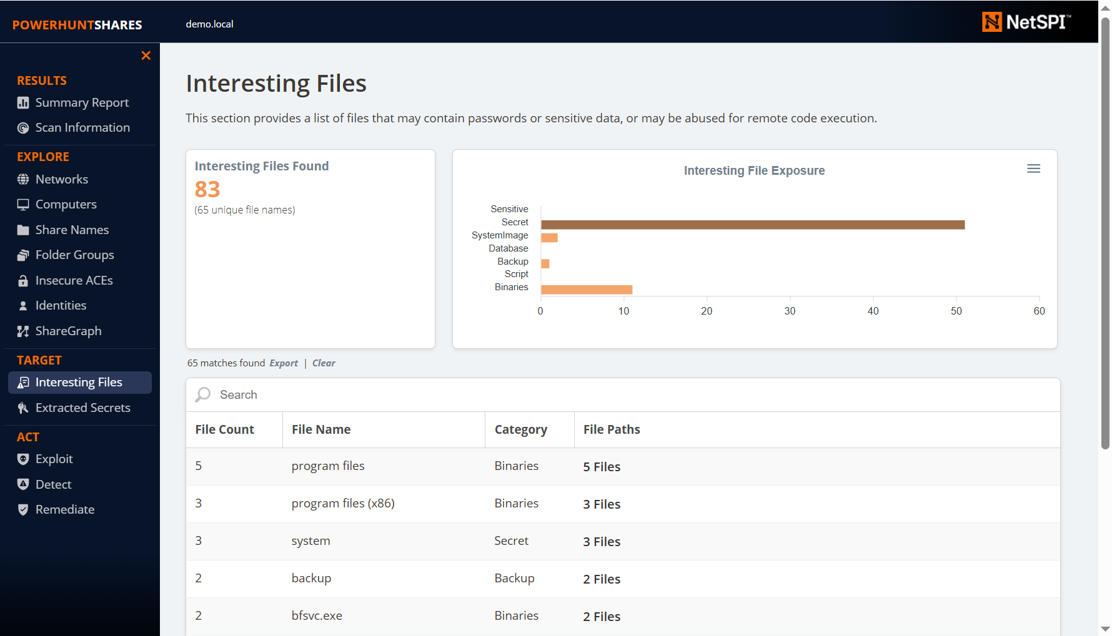
Static Labeling
Summary
~ 50 functions to automatically extract passwords from known configuration files.
Examples:
Web.config
App.config
Machine.config
Unattend.xml
My.cnf
Tomcat-users.xml
Cisco Startup/Run Configs – Type 7 decoding
Smb.conf
Krb5.conf
Shadow
High Risk Shares
Interesting Files
Extracted Passwords
Stale (last modified date > 1yr)
Empty (no files)

Slide 43
Static Labeling … mostly :)
Summary
50 functions to automatically extract passwords from known configuration files.
Examples
Web.config
App.config
Machine.config
Unattend.xml
My.cnf
Tomcat-users.xml
Cisco Startup/Run Configs – Type 7 decoding
Smb.conf
Krb5.conf
Shadow
High Risk Shares
Interesting Files (data and secrets)
Extracting Secrets
Stale (last modified date > 1yr)
Empty (no files)

Slide 44
Static Labeling … mostly :)
Summary
~1 day of development using LLM prompt
Process Summary
Ask for top ten applications that store credentials in common categories.
Ask for links to sample configuration files and download them.
Create prompt to generate PowerShell functions to parse passwords based on a provided configuration file.
Submit prompt with configuration file
~30% required small modifications.
Repeat.
High Risk Shares
Interesting Files (data and secrets)
Extracting Secrets
Stale (last modified date > 1yr)
Empty (no files)

Slide 45
Static Labeling … mostly :)
Sample Prompt
Create a PowerShell function that parses usernames and passwords from the provided example file.
Ensure the PowerShell function supports an input parameter named “FilePath” that accepts a path to the configuration file so it can be read and parsed.
Ensure all output is provided as a PSObject. Ensure each parsed username and password pair is returned as a separate record. Output parameters should include “username” and “password”. If their values are empty in the file, then return “EMPTY” for their values in the PSObject.
Example Configuration File: Content Here
High Risk Shares
Interesting Files (data and secrets)
Extracting Secrets
Stale (last modified date > 1yr)
Empty (no files)

Slide 46
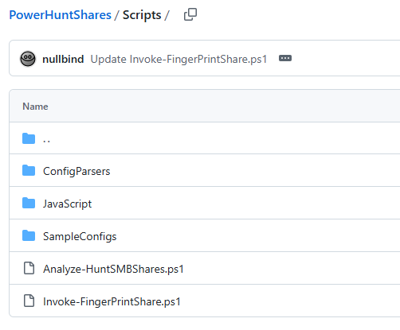
Static Labeling … mostly :)
Summary
~ 50 functions to automatically extract passwords from known configuration files.
50 Parsing Functions in Two Days using LLM
Ask for top ten applications that store credentials in common categories.
Ask for links to sample configuration files.
Build prompt:
High Risk Shares
Interesting Files (data and secrets)
Extracting Secrets
Stale (last modified date > 1yr)
Empty (no files)
Create a PowerShell Function
Input Parameters:
Output Parameters:
Notes:
The stand-alone parsers and sample configurations have been made available in the repository.

Slide 47
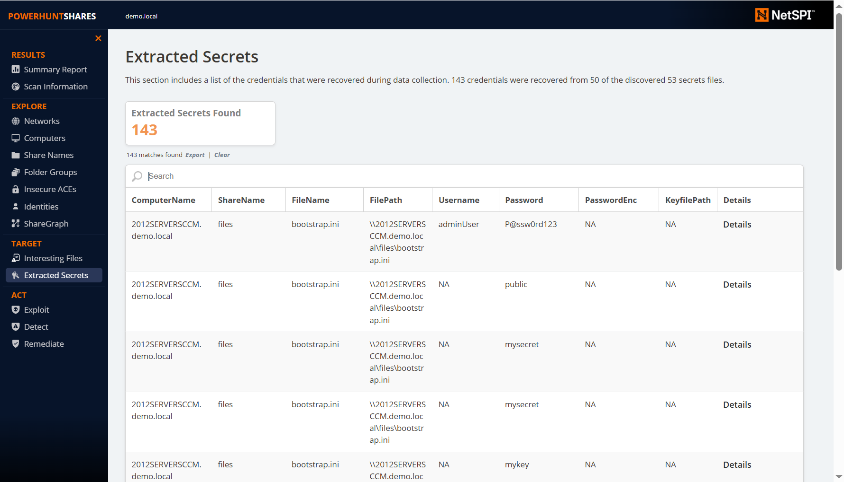
Static Labeling
Summary
~ 50 functions to automatically extract passwords from known configuration files.
Examples:
Web.config
App.config
Machine.config
Unattend.xml
My.cnf
Tomcat-users.xml
Cisco Startup/Run Configs – Type 7 decoding
Smb.conf
Krb5.conf
Shadow
High Risk Shares
Interesting Files
Extracted Passwords
Stale (last modified date > 1yr)
Empty (no files)

Slide 48
Static Labeling … mostly :)
Summary
Stale and empty share folders are exactly what they sounds like.
High Risk Shares
Interesting Files (data and secrets)
Extracting Secrets
Stale (last modified date > 1yr)
Empty (no files)

Slide 49
PowerHuntShares Process
Define
Goals
Collect
Data
Clean
Data
Transform
Data
Analyze
Data
Extract Insights & Predictions
Conclusions, Findings
& Recommendations
Take
Actions
Data
Context
Transform Data
Static Data Labeling
Highly Exploitable, Interesting Files, Secrets Extraction, Stale, Empty
+
https://github.com/NetSPI/PowerHuntShares

Slide 50

PowerHuntShares Process
Define
Goals
Collect
Data
Clean
Data
Transform
Data
Analyze
Data
Extract Insights & Predictions
Conclusions, Findings
& Recommendations
Take
Actions
Data
Context
Transform Data
Static Data Labeling
Highly Exploitable, Interesting Files, Secrets Extraction, Stale, Empty
Dynamic Data Enrichment
Fingerprinting
+
+
Context
https://github.com/NetSPI/PowerHuntShares

Slide 51


Share Fingerprinting
“What is this share used for?”
Notes:
Most administrator don’t know every share in their environment.

Slide 52

Share Fingerprinting
Why Fingerprint Shares?
“What is this share used for?”
Improve Offensive Context
Increase confidence that a share contains specific files with stored secrets, sensitive data or can be used for remote code execution.
Improve Defensive Context
Better understand the impact of removing potentially excessive privilege.
Increase confidence the share or group of shares are related to a specific application or process that can be remediated at the same time.

Slide 53
Share Fingerprinting
Summary
“What is this share used for?”
Static Hardcoded Application Fingerprint Library
~ 100 environments manually analyzed
~ 80 share names mapped to common
applications and operating systems
Pros
Better than what I had, which was nothing. ☺
Includes descriptions for the shares and related apps.
Cons
Doesn’t consider file listings which can lead to false positives.
Doesn’t include any fuzzy logic to account for share name variations which can lead to false negatives.
Currently doesn’t output CPE.

Slide 54
Share Fingerprinting
“What is this share used for?”
Static Hardcoded Application Fingerprint Library
Dynamic LLM-Based Application Fingerprinting

Slide 55
Share Fingerprinting
LLM-Based Process
Phase 1: Fingerprinting
Phase 2: Normalize Application Names
Phase 3: Generate Summary Report
Prompt
Template
GPT
4o
Application
Fingerprint
+
Confidence+
Justification
+
Sample
Prompt
Template
GPT
4o
Normalized
Application
Names
Prompt
Template
GPT
4o
Application Volume and Category Summary
+
+
+
Share Name
List of
Application
Fingerprints
Normalized
Application List
+
File Listing
Output
CSV
Output
CSV
Output
HTML Report

Slide 56
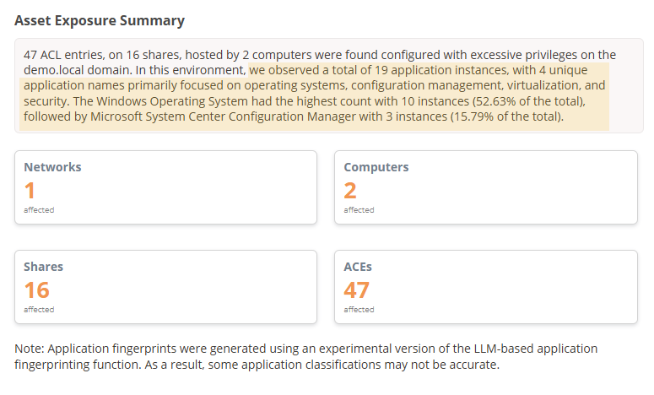
Share Fingerprinting
LLM-Based Process
Phase 1: Fingerprinting
Phase 2: Normalize Application Names
Phase 3: Generate Summary Report
Prompt
Template
GPT
4o
Application
Fingerprint
+
Confidence+
Justification
+
Sample
Prompt
Template
GTP
4o
Normalized
Application
Names
Prompt
Template
GTP
4o
Application Volume and Category Summary
+
+
+
Share Name
List of
Application
Fingerprints
Normalized
Application List
+
File Listing
Output
CSV
Output
HTML Report

Slide 57
Share Fingerprinting
Summary
LLM-Based Process
~ 50 functions to automatically extract passwords from known configuration files.
50 Parsing Functions in Two Days using LLM
Ask for top ten applications that store credentials in common categories.
Ask for links to sample configuration files.
Build prompt:
Phase 1: Fingerprinting
Phase 2: Normalize Application Names
Phase 3: Generate Summary Report
Prompt
Template
GPT
4o
Application
Fingerprint
+
Confidence+
Justification
+
Sample
Prompt
Template
GTP
4o
Normalized
Application
Names
Prompt
Template
GTP
4o
Application Volume and Category Summary
+
+
+
Share Name
List of
Application
Fingerprints
Normalized
Application List
+
Create a PowerShell Function
Input Parameters:
Output Parameters:
File Listing
Output
CSV
Output
HTML Report

Slide 58
Share Fingerprinting
Lessons Learnd
“What is this share used for?”
Static Hardcoded Application Fingerprint Library
Dynamic LLM-Based Application Fingerprinting
Large context windows != Accuracy
Break problem into smaller parts
Use explicit instructions
Run multiple iterations
Generate confidence scores
Generate justification
XML > JSON

Slide 59
Share Fingerprinting
Summary
“What is this share used for?”
Static Hardcoded Application Fingerprint Library
Dynamic LLM-Based Application Fingerprinting
Pros
Can account for things I’ve never seen before.
Cons
We still have some hallucinations.
Does not include vendor name is a separate field.
Does not output CPE in the current version.

Slide 60
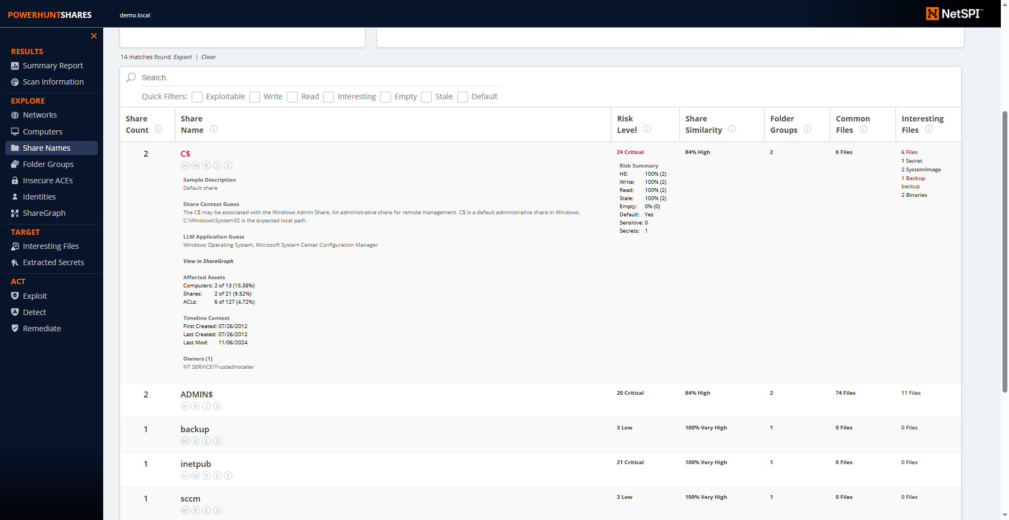
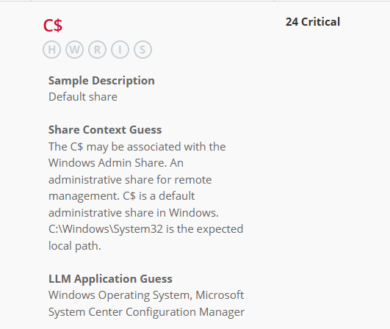

Demo
PowerHuntShares.
LLM share name fingerprinting.

Slide 61
PowerHuntShares Process
Define
Goals
Collect
Data
Clean
Data
Transform
Data
Analyze
Data
Extract Insights & Predictions
Conclusions, Findings
& Recommendations
Take
Actions
Data
Context
Transform Data
Static Data Labeling
Highly Exploitable, Interesting Files, Secrets Extraction, Stale, Empty
Dynamic Data Enrichment
Fingerprinting
+
+
Context
https://github.com/NetSPI/PowerHuntShares

Slide 62

PowerHuntShares Process
Define
Goals
Collect
Data
Clean
Data
Transform
Data
Analyze
Data
Extract Insights & Predictions
Conclusions, Findings
& Recommendations
Take
Actions
Data
Context
Transform Data
Static Data Labeling
Highly Exploitable, Interesting Files, Secrets Extraction, Stale, Empty
Dynamic Data Enrichment
Fingerprinting, Risk Scoring
+
+
Context
+
Context
https://github.com/NetSPI/PowerHuntShares

Slide 63
Risk Scoring
“Be honest, how bad is it?”

Slide 64
Risk Scoring
Summary
“Be honest, how bad is it?”
Summary
The PowerHuntShares risk score is a simple formula that helps evaluate and rank risk associated with shares based simple questions.

Slide 65
Risk Scoring
Summary
“Be honest, how bad is it?”
Summary
Why Risk Scores?
The PowerHuntShares risk score is a simple formula that helps evaluate and rank risk associated with shares based simple questions.
Why Risk Scores?
Help prioritize exploitation
Help prioritized remediation
Add context related to abuse impact
Why Another Risk Rating?
CVSS didn’t provide the data context and volume in the way I wanted.

Slide 66

Risk Scoring
Summary
“Be honest, how bad is it?”
Summary
Why Risk Scores
Formula Abstract
The PowerHuntShares risk score is a simple formula that helps evaluate and rank risk associated with shares based simple questions.
Formula Abstract
Share
Weight Variables
Assign Score
Extract
RCE (16)
Sum
CRITICAL
> 20
Sensitive Data (8)
Secrets (2)
HIGH
11 - 20
Write Access (5)
MEDIUM
5 - 10
Read Access (3)
Empty (-1)
LOW
0 - 4
Stale (1yr) (-1)

Slide 67
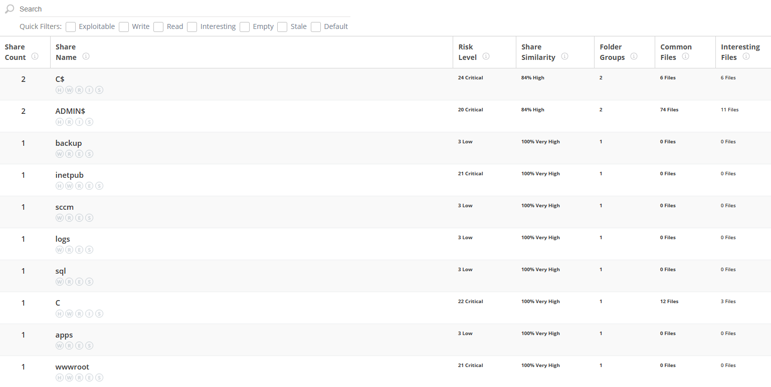
Risk Scoring
Summary
“Be honest, how bad is it?”
Summary
Why Risk Scores
Formula Abstract
The PowerHuntShares risk score is a simple formula that helps evaluate and rank risk associated with shares based simple questions.
Formula Abstract
Share
Weight Variables
Assign Score
Extract
RCE (16)
Sum
CRITICAL
> 20
Sensitive Data (8)
Secrets (2)
HIGH
11 - 20
Write Access (5)
MEDIUM
5 - 10
Read Access (3)
Empty (-1)
LOW
0 - 4
Stale (1yr) (-1)

Slide 68
PowerHuntShares Process
Define
Goals
Collect
Data
Clean
Data
Transform
Data
Analyze
Data
Extract Insights & Predictions
Conclusions, Findings
& Recommendations
Take
Actions
Data
Context
Transform Data
Static Data Labeling
Highly Exploitable, Interesting Files, Password, Extraction, Stale, Empty
Dynamic Data Enrichment
Fingerprinting, Risk Scoring
+
+
Context
+
Context
https://github.com/NetSPI/PowerHuntShares

Slide 69

PowerHuntShares Process
Define
Goals
Collect
Data
Clean
Data
Transform
Data
Analyze
Data
Extract Insights & Predictions
Conclusions, Findings
& Recommendations
Take
Actions
Data
Context
Transform Data
Static Data Labeling
Highly Exploitable, Interesting Files, Password, Extraction, Stale, Empty
Dynamic Data Enrichment
Fingerprinting, Risk Scoring, Peer Comparison
+
+
Context
+
Context
+
Context
https://github.com/NetSPI/PowerHuntShares

Slide 70
Peer Comparison
Summary
Companies want to understand what’s normal and where they fall short and when they are overachieving.
“ So, we have 1,000 critical risk shares, really?...
Use Cases
…..Good to know, but how do we compare to our peers? ”
Acquire Budget.
Use as KPI.
Tested Approaches
Do nothing. PowerHuntShares v1
Historical Averages. PowerHuntShares v2
Predictive Models. PowerHuntShares v3?

Slide 71
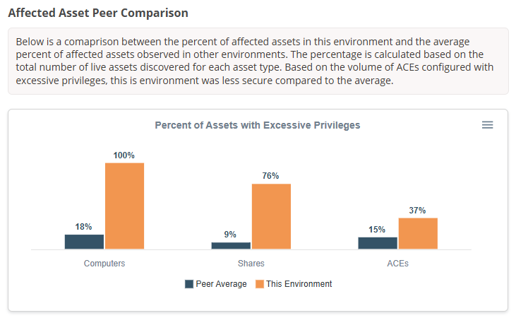
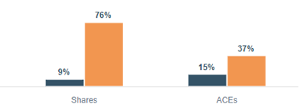
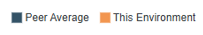
Peer Comparison
Historical Average

Slide 72
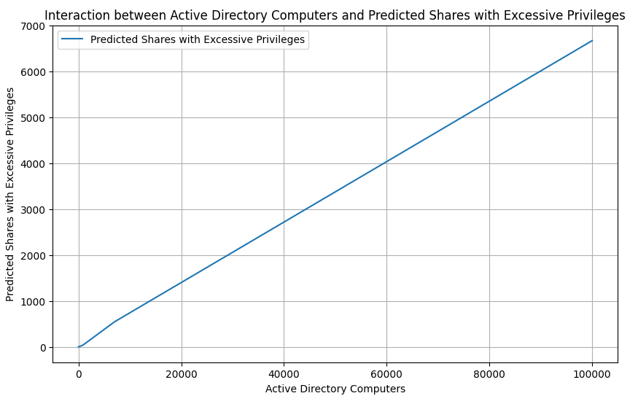
Peer Comparison
Summary
Predictive Models
....
Select the most meaningful features to help prediction
Simple linear regression model
System count
Trust count
Use case: sanity check. Is the environment better or worst than expected for the size
Linear Regression
Randomforest Neural Network
Worst than Predicted
import pandas as pd
import numpy as np
from sklearn.model_selection import train_test_split
from sklearn.preprocessing import StandardScaler
from sklearn.metrics import mean_squared_error
import tensorflow as tf
from tensorflow.keras.models import Sequential
from tensorflow.keras.layers import Dense
import matplotlib.pyplot as plt
import shap
# Load data
file_path = r"C:\tools\data2.csv"
df = pd.read_csv(file_path)
Predicted Count of
Excessive Shares
2k systems
Better than Predicted
Did they do something right, or did I do something wrong?
If its too good to be true, it usually is.
Neural Network
Notes:
Worst: What’s wrong, people, process, or technology?
Better: Is something right, or did we do something wrong?

Slide 73
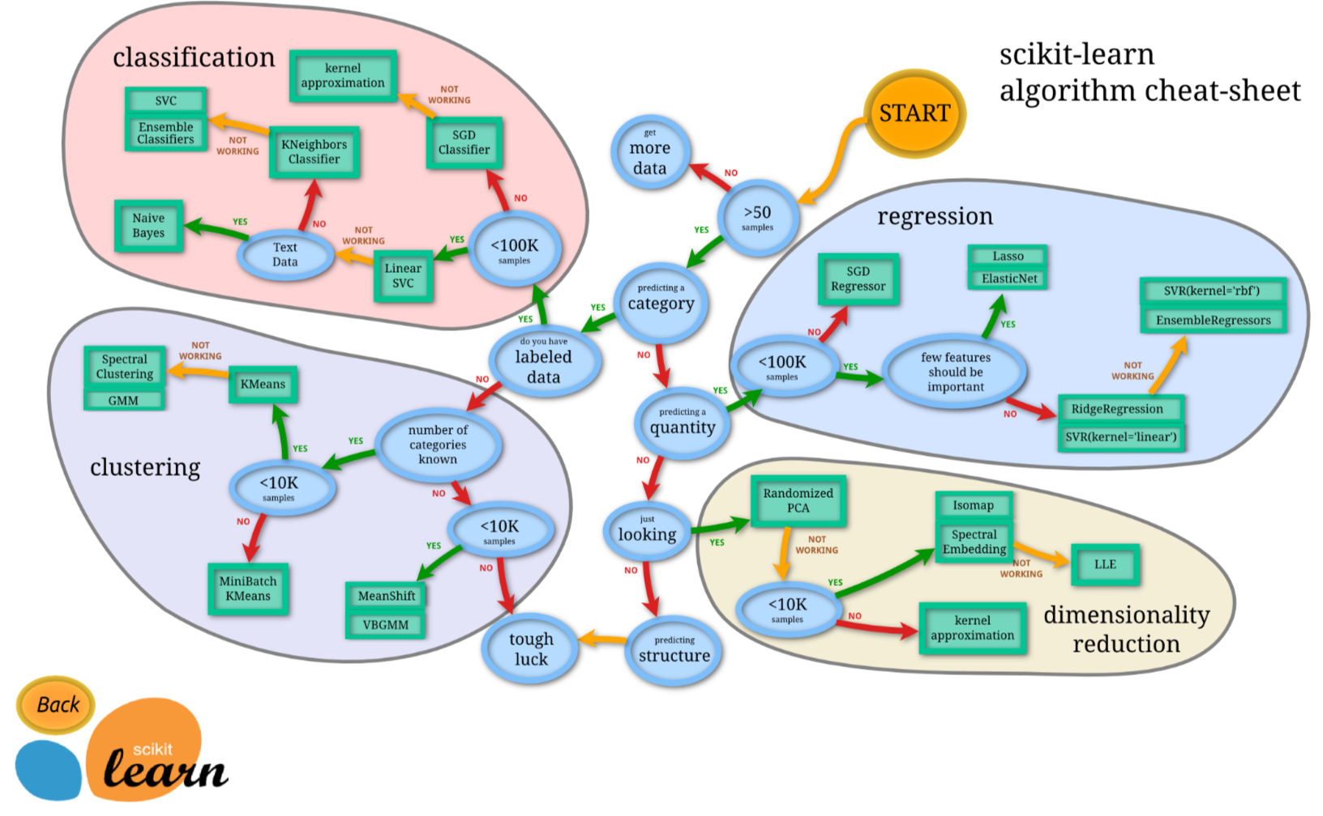
Peer Comparison
Summary
Predictive Models
....
Select the most meaningful features to help prediction
Simple linear regression model
System count
Trust count
Use case: sanity check. Is the environment better or worst than expected for the size
Linear Regression
Randomforest Neural Network
Worst than Predicted
import pandas as pd
import numpy as np
from sklearn.model_selection import train_test_split
from sklearn.preprocessing import StandardScaler
from sklearn.metrics import mean_squared_error
import tensorflow as tf
from tensorflow.keras.models import Sequential
from tensorflow.keras.layers import Dense
import matplotlib.pyplot as plt
import shap
# Load data
file_path = r"C:\tools\data2.csv"
df = pd.read_csv(file_path)
Predicted Count of
Excessive Shares
2k systems
Better than Predicted

Slide 74
Peer Comparison
Summary
Predictive Models
Anyone port that to PowerShell yet?
....
Select the most meaningful features to help prediction
Simple linear regression model
System count
Trust count
Use case: sanity check. Is the environment better or worst than expected for the size
Linear Regression
Randomforest Neural Network
Worst than Predicted
ML-DOTNET
https://dotnet.microsoft.com/en-us/apps/ai/ml-dotnet
import pandas as pd
import numpy as np
from sklearn.model_selection import train_test_split
from sklearn.preprocessing import StandardScaler
from sklearn.metrics import mean_squared_error
import tensorflow as tf
from tensorflow.keras.models import Sequential
from tensorflow.keras.layers import Dense
import matplotlib.pyplot as plt
import shap
# Load data
file_path = r"C:\tools\data2.csv"
df = pd.read_csv(file_path)
Predicted Count of
Excessive Shares
2k systems
Maybe in PowerHuntShare v3 ;)
Better than Predicted
Notes:
https://dotnet.microsoft.com/en-us/apps/ai/ml-dotnet

Slide 75
PowerHuntShares Process
Define
Goals
Collect
Data
Clean
Data
Transform
Data
Analyze
Data
Extract Insights & Predictions
Conclusions, Findings
& Recommendations
Take
Actions
Data
Context
Transform Data
Static Data Labeling
Highly Exploitable, Interesting Files, Secrets Extraction, Stale, Empty
Dynamic Data Enrichment
Fingerprinting, Risk Scoring, Peer Comparison
+
+
Context
+
Context
+
Context
https://github.com/NetSPI/PowerHuntShares

Slide 76

PowerHuntShares Process
Define
Goals
Collect
Data
Clean
Data
Transform
Data
Analyze
Data
Extract Insights & Predictions
Conclusions, Findings
& Recommendations
Take
Actions
Data
Context
Transform Data
Static Data Labeling
Highly Exploitable, Interesting Files, Secrets Extraction, Stale, Empty
Dynamic Data Enrichment
Fingerprinting, Risk Scoring, Peer Comparison, Grouping & Similarity Scoring
+
+
Context
+
Context
+
Context
https://github.com/NetSPI/PowerHuntShares

Slide 77

Grouping & Similarity
“How can I group similar shares so I can take fewer targeted actions?”

Slide 78
Grouping & Similarity
Why Group Shares?
“How can I group similar shares so I can take fewer targeted actions?”
Offensive Action Target Consolidation
Secrets extraction
Sensitive data extractions
Remote code execution
Defensive Action Target Consolidation
Groups assets part of the same process or application with confidence
Prioritize large groups of vulnerable assets at once
Remediate groups of similar assets at the same time

Slide 79
Grouping & Similarity
Summary
“How can I group similar shares so I can take targeted actions?”
Group by Share Name
Group shares together by their name as the sole means of determining similarity.

Slide 80
Grouping & Similarity
Summary
“How can I group similar shares so I can take targeted actions?”
Group by Share Name
Group shares together by their name as the sole means of determining similarity.
Share Name
Apps
Logs
Logs
C$
The shares named “logs” get grouped together.

Slide 81
Grouping & Similarity
Summary
“How can I group similar shares so I can take targeted actions?”
Group by Share Name
Group shares together by their name as the sole means of determining similarity.
Pros
Fast and easy to execute via common query syntax.
Works great if the shares were created to support the same process or application at the same time.
Cons
Works poorly if shares have the same name but they are NOT related. Which happens a lot.
Works poorly when you want to consider other factors like, who owns the shares, data exposure risk, rce risk, or when shares were created, modified, or accessed.

Slide 82
Grouping & Similarity
Summary
“How can I group similar shares so I can take targeted actions?”
Group by Share Name
Group shares together by their name as the sole means of determining similarity.
Example Queries
SQL QUERY
SELECT ShareName, COUNT(ShareName) AS ShareCount
FROM Shares
GROUP BY ShareName
ORDER BY ShareCount DESC;
PowerShell Example
$Shares | Group-Object | Sort-Object Count -Descending | Select-Object Count, Name

Slide 83
Grouping & Similarity
Summary
“How can I group similar shares so I can take targeted actions?”
Group by Share Name
Group shares together by their name as the sole means of determining similarity.
Example Output
ShareName Count
Logs 2
Apps 1
C$ 1

Slide 84
Grouping & Similarity
Summary
“How can I group similar shares so I can take targeted actions?”
Group by Share Name
Group by Folder Group (Dir Hash)
Folder groups are MD5 hashes of a share's file listing.

Slide 85
Grouping & Similarity
Summary
“How can I group similar shares so I can take targeted actions?”
Group by Share Name
Group by Folder Group (Dir Hash)
Folder groups are MD5 hashes of a share's file listing.
Share Name
Share 1
Share 2
Share 3
Share 4
File1.txt
File2.txt
File2.txt
File3.txt
File4.txt
File1.txt
File2.txt
File List
File List Hash
ASDF
LKJH
POIU
ASDF

Slide 86
Grouping & Similarity
Summary
“How can I group similar shares so I can take targeted actions?”
Group by Share Name
Group by Folder Group (Dir Hash)
Folder groups are MD5 hashes of a share's file listing.
Share Name
Share 1
Share 2
Share 3
Share 4
File1.txt
File2.txt
File2.txt
File3.txt
File4.txt
File1.txt
File2.txt
File List
File List Hash
ASDF
LKJH
POIU
ASDF
Share 1 & 4
will have the same
“Folder Group” hash.

Slide 87
Grouping & Similarity
Summary
“How can I group similar shares so I can take targeted actions?”
Group by Share Name
Group by Folder Group (Dir Hash)
Folder groups are MD5 hashes of a share's file listing.
Share Name
Share 1
Share 2
Share 3
Share 4
File1.txt
File2.txt
File2.txt
File3.txt
File4.txt
File1.txt
File2.txt
File List
File List Hash
ASDF
LKJH
POIU
ASDF
Share 1 & 4
are have EXACTLY
the same file list

Slide 88
Grouping & Similarity
Summary
“How can I group similar shares so I can take targeted actions?”
Group by Share Name
Group by Folder Group (Dir Hash)
Folder groups are MD5 hashes of a share's file listing.
Pros
Condensed representation of fil list for quick display, filtering and sorting.
Fast and easy to execute via common query syntax & functions.
Great for finding shares that have the EXACT SAME list of files at the root level.
Cons
Works poorly when the shares DO NOT have the exact same list of files but are used by the same application. Which happens a lot.
Folder groups functionality in PowerHuntShares does not currently include nested folder listings.

Slide 89
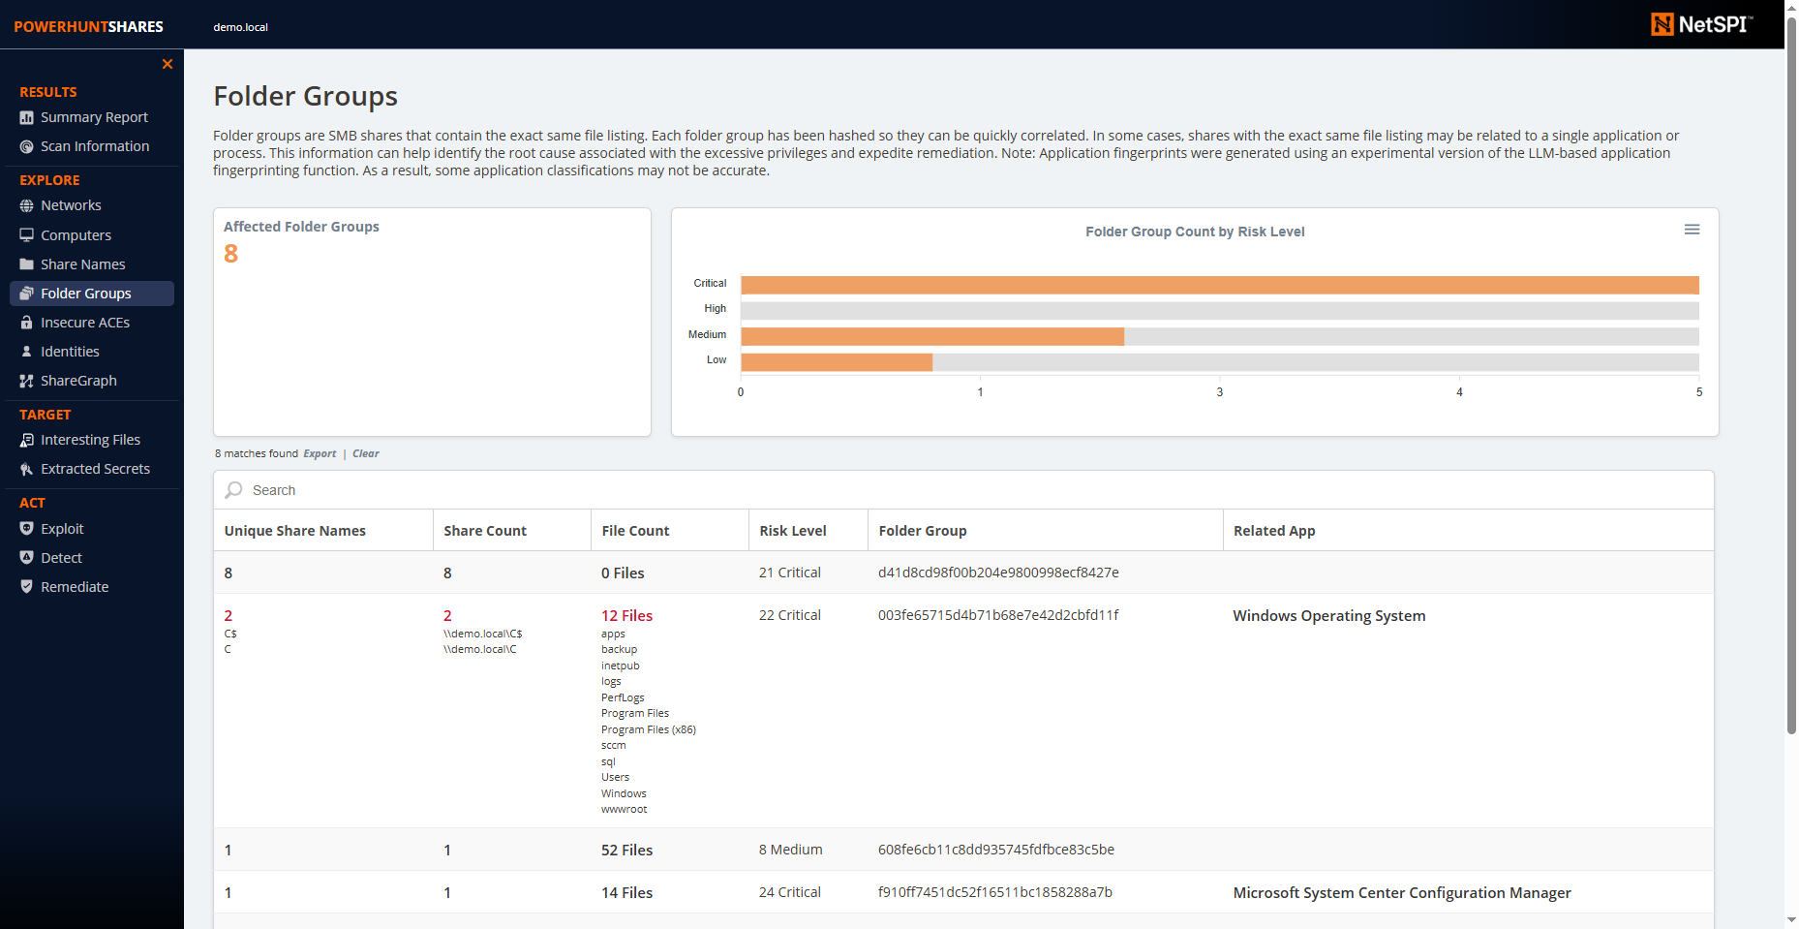
Grouping & Similarity
Summary
“How can I group similar shares so I can take targeted actions?”
Group by Share Name
Group by Folder Group (Dir Hash)
Folder groups are MD5 hashes of a share's file listing.
Pros
Condensed representation of fil list for quick display, filtering and sorting.
Fast and easy to execute via common query syntax & functions.
Great for finding shares that have the EXACT SAME list of files at the root level.
Cons
Works poorly when the shares DO NOT have the exact same list of files but are used by the same application. Which happens a lot.
Folder groups functionality in PowerHuntShares does not currently include nested folder listings.
Notes:
Example that are common:
Backup folders.
Dev folders.
Default drives.

Slide 90
Grouping & Similarity
Summary
“How can I group similar shares so I can take targeted actions?”
Group by Share Name
Group by Folder Group (Dir Hash)
Group by Merkle Hash (Nested Dir Hash)
A Merkle Tree is hashing technique that can be applied to any hierarchal structures and has been traditionally used for data integrity validation.
Notes:
Merkle Trees follow a hierarchal node edge model.
The items are call leaf nodes.
The hashes are called hash nodes.
The root is call the root

Slide 91
Merkle Trees Hierarchal Graph
Node
A Merkle Tree is hashing technique that can be applied to any hierarchal structures and has been traditionally used for data integrity validation.
Edge
Notes:
Merkle Trees follow a hierarchal node edge model.

Slide 92
Merkle Trees Root Nodes
Root Node
Notes:
The top node is called the “root” node.

Slide 93
Merkle Trees Parent Nodes
Root Node
Parent Node
Parent Node
Parent Node
Parent Node
Notes:
Nodes containing one or more children are called “parent” nodes.

Slide 94
Merkle Trees Child Nodes
Root Node
Parent Node
Parent Node
Parent Node
Child Node
Child Node
Child Node
Child Node
Child Node
Notes:
Nodes containing one or more children are called “parent” nodes.

Slide 95
Merkle Trees Leaf Nodes
Root Node
Parent Node
Parent Node
Parent Node
Child Node
Leaf Node
Leaf Node
Leaf Node
Leaf Node
Notes:
Leaf nodes have no children.

Slide 96
Merkle Trees Hashing Process
Dog
Fish
Rat
Frog
Lizard
Horse
Rabbit
Bird
A
B
C
D
E
F
G
H
Notes:
Hashing works from the bottom up.

Slide 97
Merkle Trees Hashing Process
Hash the leaf node data.
H(A)
H(B)
H(C)
H(D)
H(E)
H(F)
H(G)
H(H)
Dog
Fish
Rat
Frog
Lizard
Horse
Rabbit
Bird
A
B
C
D
E
F
G
H
Notes:
Hashing works from the bottom up.

Slide 98
Merkle Trees Hashing Process
Hash the leaf node data.
Group the leaf nodes into pairs and hash their hashes.
H(AB)
H(CD)
H(EF)
H(GH)
H(A)
H(B)
H(C)
H(D)
H(E)
H(F)
H(G)
H(H)
Dog
Fish
Rat
Frog
Lizard
Horse
Rabbit
Bird
A
B
C
D
E
F
G
H
Notes:
Hashing works from the bottom up.

Slide 99
Merkle Trees Hashing Process
Hash the leaf node data.
Group the leaf nodes into pairs and hash their hashes.
Repeat with the parent nodes until root.
H(ABCD)
H(EFGH)
H(AB)
H(CD)
H(EF)
H(GH)
H(A)
H(B)
H(C)
H(D)
H(E)
H(F)
H(G)
H(H)
Dog
Fish
Rat
Frog
Lizard
Horse
Rabbit
Bird
A
B
C
D
E
F
G
H
Notes:
Hashing works from the bottom up.

Slide 100
Merkle Trees Hashing Process
H(ABCDEFGH)
Hash the leaf node data.
Group the leaf nodes into pairs and hash their hashes.
Repeat with the parent nodes until root.
H(ABCD)
H(EFGH)
H(AB)
H(CD)
H(EF)
H(GH)
H(A)
H(B)
H(C)
H(D)
H(E)
H(F)
H(G)
H(H)
Dog
Fish
Rat
Frog
Lizard
Horse
Rabbit
Bird
A
B
C
D
E
F
G
H
Notes:
Hashing works from the bottom up.

Slide 101
Merkle Trees Hashing Process
H(ABCDEFGH)
Hash the leaf node data.
Group the leaf nodes into pairs and hash their hashes.
Repeat with the parent nodes until root.
H(ABCD)
H(EFGH)
H(AB)
H(CD)
H(EF)
H(GH)
H(A)
H(B)
H(C)
H(D)
H(E)
H(F)
H(G)
H(H)
Change
Dog
Fish
Rat
Frog
Lizard
Horse
Rabbit
Bird
A
B
C
D
E
F
G
H
Notes:
Hashing works from the bottom up.

Slide 102
Merkle Trees Hashing Process
H(ABCDEFGH)
Hash the leaf node data.
Group the leaf nodes into pairs and hash their hashes.
Repeat with the parent nodes until root.
H(ABCD)
H(EFGH)
H(AB)
H(CD)
H(EF)
H(GH)
H(A)
H(B)
H(C)
H(D)
H(E)
H(F)
H(G)
H(H)
Change
Cat
Fish
Rat
Frog
Lizard
Horse
Rabbit
Bird
A
B
C
D
E
F
G
H
Notes:
Hashing works from the bottom up.

Slide 103
Grouping & Similarity
Summary
“How can I group similar shares so I can take targeted actions?”
Group by Share Name
Group by Folder Group (Dir Hash)
Group by Merkle Hash (Nested Dir Hash)
A Merkle Tree is hashing technique that can be applied to any hierarchal structures and has been traditionally used for data integrity validation.
Common Use Cases
Blockchain
Certificate Transparency Logs
P2P File Transfers
Database indexing
Share Use Case
Merkle Trees can also be used to expand on the idea of the “Folder group” by hashing the file listings recursively so you can identify single folder matches as well as hierarchical folder structure matches

Slide 104
Merkle Tree (Modified)
Share Use Case
SubFolderA
H(A)
Secrets.txt
A
Notes:
We process one share at a time from the bottom up.
We start with the deepest sub folder.

Slide 105
Merkle Tree (Modified)
Share Use Case
HASH 1 - H(A)
Simple Folder List
Hashes
SubFolderA
H(A)
Secrets.txt
A
Notes:
Each sub folder is hashed individually just like when we did the folder list hashing earlier.

Slide 106
Merkle Tree (Modified)
Share Use Case
HASH 1 - H(A)
HASH 2 - H(B)
Simple Folder List
Hashes
SubFolderA
H(A)
SubFolderB
H(B)
Secrets.txt
trees.txt
A
B
Notes:
We then process the other sub folder in the same directory on the same share.

Slide 107
Merkle Tree (Modified)
Share Use Case
HASH 1 - H(A)
HASH 2 - H(B)
HASH 3 - H(C)
Simple Folder List
Hashes
FolderC
H(C)
H(ABC)
my.cfg
db.doc
SubFolderA
SubFolderB
C
SubFolderA
H(A)
SubFolderB
H(B)
Secrets.txt
trees.txt
A
B
Notes:
Once all of those subfolders are done then we move up a directly level.
Initially we simply create a standard hash for its files as well.

Slide 108
Merkle Tree (Modified)
Share Use Case
HASH 1 - H(A)
HASH 2 - H(B)
HASH 3 - H(C)
HASH 4 - H(ABC)
Simple Folder List
Hashes
FolderC
H(C)
H(ABC)
Hierarchical Structure
Hashes
my.cfg
db.doc
SubFolderA
SubFolderB
C
SubFolderA
H(A)
SubFolderB
H(B)
Secrets.txt
trees.txt
A
B
Notes:
However, we also hash its folder group hashes, with the merkle-ish has of its sub folders.
That provides us with a hierarchy we can use for comparison later.

Slide 109
Merkle Tree (Modified)
Share Use Case
HASH 1 - H(A)
HASH 2 - H(B)
HASH 3 - H(C)
HASH 4 - H(ABC)
HASH 5 - H(D)
Simple Folder List
Hashes
FolderC
H(C)
H(ABC)
FolderD
H(D)
Hierarchical Structure
Hashes
my.cfg
db.doc
SubFolderA
SubFolderB
a.xls
b.doc
C
D
SubFolderA
H(A)
SubFolderB
H(B)
Secrets.txt
trees.txt
A
B
Notes:
We then process the other folders at that level as we did before.

Slide 110
Merkle Tree (Modified)
Share Use Case
Share Root
H(Root)
H(H(ABC) + H(D) + H(Root))
HASH 1 - H(A)
HASH 2 - H(B)
HASH 3 - H(C)
HASH 4 - H(ABC)
HASH 5 - H(D)
HASH 6 - H(Root)
HASH 7 - H(ABC) + H(D)
Simple Folder List
Hashes
FolderC
H(C)
H(ABC)
FolderD
H(D)
Hierarchical Structure
Hashes
my.cfg
db.doc
SubFolderA
SubFolderB
a.xls
b.doc
C
D
SubFolderA
H(A)
SubFolderB
H(B)
Secrets.txt
trees.txt
A
B
Notes:
In this case the root creates is own “folder group” hash to add to the database, AND a merkle-ish hash to reflect its full structure.
In this way we have an inventory of all file directories, and their structures and can query then using simple group by queries.

Slide 111
Merkle Tree (Modified)
Share Use Case
Share Root
H(Root)
H(H(ABC) + H(D) + H(Root))
HASH 1 - H(A)
HASH 2 - H(B)
HASH 3 - H(C)
HASH 4 - H(ABC)
HASH 5 - H(D)
HASH 6 - H(Root)
HASH 7 - H(ABC) + H(D)
Simple Folder List
Hashes
FolderC
H(C)
H(ABC)
FolderD
H(D)
Hierarchical Structure
Hashes
my.cfg
db.doc
SubFolderA
SubFolderB
a.xls
b.doc
If we store all the hashes in a table, we can then perform simple SQL GROUP BY operations like the “Folder Groups”, but this time we can also see groups of folder hierarchies. ☺
C
D
SubFolderA
H(A)
SubFolderB
H(B)
Secrets.txt
trees.txt
A
B
Notes:
In this case the root creates is own “folder group” hash to add to the database, AND a merkle-ish hash to reflect its full structure.
In this way we have an inventory of all file directories, and their structures and can query then using simple group by queries.

Slide 112
Merkle Tree (Modified)
Share Use Case
Share Root
H(Root)
H(H(ABC) + H(D) + H(Root))
HASH 1 - H(A)
HASH 2 - H(B)
HASH 3 - H(C)
HASH 4 - H(ABC)
HASH 5 - H(D)
HASH 6 - H(Root)
HASH 7 - H(ABC) + H(D)
Simple Folder List
Hashes
FolderC
H(C)
H(ABC)
FolderD
H(D)
Hierarchical Structure
Hashes
my.cfg
db.doc
SubFolderA
SubFolderB
a.xls
b.doc
If we store all the hashes in a table, we can then perform simple SQL GROUP BY operations like the “Folder Groups”, but this time we can also see groups of folder hierarchies. ☺
C
D
SubFolderA
H(A)
SubFolderB
H(B)
Secrets.txt
trees.txt
A
B
Notes:
In this case the root creates is own “folder group” hash to add to the database, AND a merkle-ish hash to reflect its full structure.
In this way we have an inventory of all file directories, and their structures and can query then using simple group by queries.

Slide 113
MyApp$
H(Root)
H(H(ABC) + H(D) + H(Root))
RandomShare
H(Root)
H(H(A) + H(ROOT))
FolderC
H(C)
H(ABC)
FolderD
H(D)
SubFolderA
H(A)
my.cfg
db.doc
SubFolderA
SubFolderB
a.xls
b.doc
Secrets.txt
C
D
A
SubFolderA
H(A)
SubFolderB
H(B)
Secrets.txt
trees.txt
A
B
Notes:
Look kids those shares are related!

Slide 114
Grouping & Similarity
Our Use Case
“How can I group similar shares so I can take targeted actions?”
Group by Share Name
Group by Folder Group (Dir Hash)
Group by Merkle Hash (Nested Dir Hash)
Merkle Trees can also be used to expand on the idea of the “Folder group” by hashing the file listings recursively so you can identify nested folder and file listing structure at any folder level.
Pros
Can surfacing relationships between shares.
Works great for grouping hierarchies with EXACT structural match.
Can be used for hunting for threats and vulnerabilities based on folder, registry memory, database, code structures etc.
Cons
Works poorly when the shares DO NOT have the exact same list of files but are used by the same application. Which happens a lot.
Collecting recursive directly listings from shares deeper than 3 levels can take a long time in large environments.

Slide 115
Grouping & Similarity
Summary
“How can I group similar shares so I can take targeted actions?”
Group by Share Name
Group by Folder Group (Dir Hash)
Group by Merkle Hash (Nested Dir Hash)
Calculate weighted similarity score
The weighted similarity score used to group shares in PowerHuntShares v2 is derived from multiple data points which are normalized to determine the percentage of similarity.
Logic Abstract
Similarity Score
Share Name Match
Filename %Coverage
FG %Coverage
85%
Creation/Share Ratio
Weight
Normalize
LastMod/Share Ratio
Owner/Share Ratio
FG/Share Ratio
Desc/Share Ratio

Slide 116
Grouping & Similarity
Summary
“How can I group similar shares so I can take targeted actions?”
Group by Share Name
Group by Folder Group (Dir Hash)
Group by Merkle Hash (Nested Dir Hash)
Calculate weighted similarity score
The similarity score in PowerHuntShares v2 is derived from the following meta data:
Pros
More accurate than the other methods alone.
More granular metrics provide more information for root cause analysis. Example: Date & owner differences can tell a story.
Cons
Does not take into account fingerprints.
Does not take into account Merkle Hashes.
Does not take into account file contents.
Note: The same approach could be applied to almost any file storage medium. For example: AWS s3, Azure blob, or GCP storage.

Slide 117
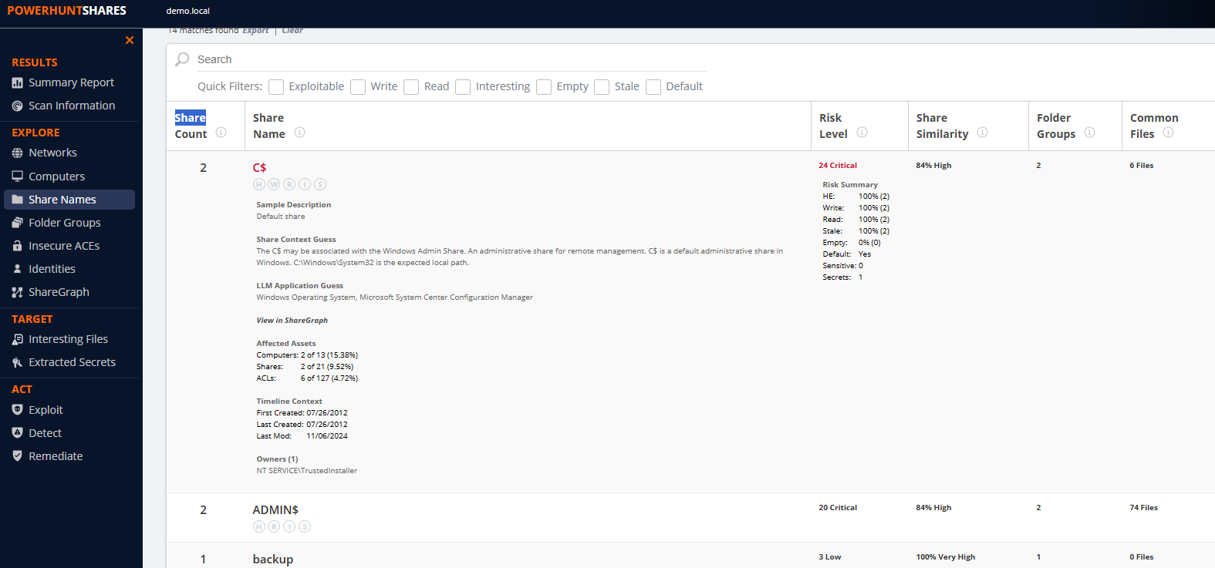
Grouping & Similarity
Summary
“How can I group similar shares so I can take targeted actions?”
Group by Share Name
Group by Folder Group (Dir Hash)
Group by Merkle Hash (Nested Dir Hash)
Calculate weighted similarity score
The weighted similarity score used to group shares in PowerHuntShares v2 is derived from multiple data points which are normalized to determine the percentage of similarity.
Logic Abstract
Similarity Score
Share Name Match
Filename %Coverage
FG %Coverage
85%
Creation/Share Ratio
Weight
Normalize
LastMod/Share Ratio
Owner/Share Ratio
FG/Share Ratio
Desc/Share Ratio
Notes:
We can see it at the share name group level

Slide 118
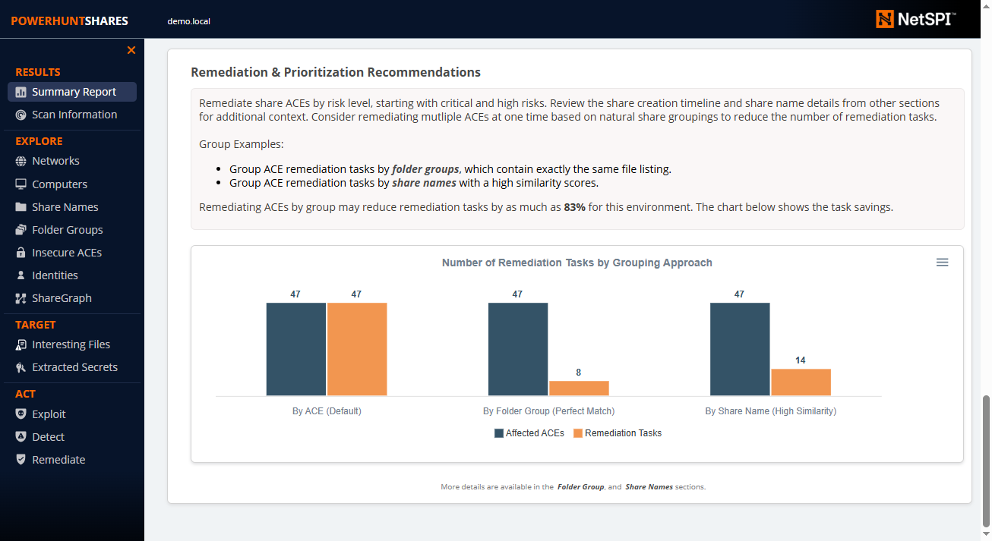
Grouping & Similarity
Summary
“How can I group similar shares so I can take targeted actions?”
Group by Share Name
Group by Folder Group (Dir Hash)
Group by Merkle Hash (Nested Dir Hash)
Calculate weighted similarity score
The weighted similarity score used to group shares in PowerHuntShares v2 is derived from multiple data points which are normalized to determine the percentage of similarity.
Logic Abstract
Similarity Score
Share Name Match
Filename %Coverage
FG %Coverage
85%
Creation/Share Ratio
Weight
Normalize
LastMod/Share Ratio
Owner/Share Ratio
FG/Share Ratio
Desc/Share Ratio
Notes:
We can use the groups to understand how much we could reduce our effort using different approaches
All
Folder – perfect match
High Similarity – not perfect but likely to be similar
--
This round folder groups seem like the clear winner. That’s not always the case, but it is here.

Slide 119


PowerHuntShares Process
Define
Goals
Collect
Data
Clean
Data
Transform
Data
Analyze
Data
Extract Insights & Predictions
Conclusions, Findings
& Recommendations
Take
Actions
Reduce Risk
with Fewer Actions

Slide 120
PowerHuntShares Process
Define
Goals
Collect
Data
Clean
Data
Transform
Data
Analyze
Data
Extract Insights & Predictions
Conclusions, Findings
& Recommendations
Take
Actions
Reduce Risk
with Fewer Actions

Slide 121
PowerHuntShares Process
Define
Goals
Collect
Data
Clean
Data
Transform
Data
Analyze
Data
Extract Insights & Predictions
Conclusions, Findings
& Recommendations
Take
Actions
Reduce Risk
with Fewer Actions

Slide 122
PowerHuntShares Process
Define
Goals
Collect
Data
Clean
Data
Transform
Data
Analyze
Data
Extract Insights & Predictions
Conclusions, Findings
& Recommendations
Take
Actions
Reduce Risk
with Fewer Actions

Slide 123
PowerHuntShares Process
Define
Goals
Collect
Data
Clean
Data
Transform
Data
Analyze
Data
Extract Insights & Predictions
Conclusions, Findings
& Recommendations
Take
Actions
Data
Context
Transform Data
Static Data Labeling
Highly Exploitable, Interesting Files, Secrets Extraction, Stale, Empty
Dynamic Data Enrichment
Fingerprinting, Risk Scoring, Peer Comparison, Grouping & Similarity Scoring
+
+
Context
+
Context
+
Context
https://github.com/NetSPI/PowerHuntShares

Slide 124

PowerHuntShares Process
Define
Goals
Collect
Data
Clean
Data
Transform
Data
Analyze
Data
Extract Insights & Predictions
Conclusions, Findings
& Recommendations
Take
Actions
Data
Context
Transform Data
Static Data Labeling
Highly Exploitable, Interesting Files, Secrets Extraction, Stale, Empty
Dynamic Data Enrichment
Fingerprinting, Risk Scoring, Peer Comparison, Grouping & Similarity Scoring
Convert to JSON/CSV
Convert to graph dataset
+
+
Context
+
Context
+
Context
https://github.com/NetSPI/PowerHuntShares

Slide 125

PowerHuntShares Process
Define
Goals
Collect
Data
Clean
Data
Transform
Data
Analyze
Data
Extract Insights & Predictions
Conclusions, Findings
& Recommendations
Take
Actions
Data
Context
Analyze Data
Networks, Computers, Share Names, Folder Groups, Aces, Identities
ShareGraph
Share Creation Timeline
Prioritized Recommendations
+
Context
Context
+
Context
Context
Context
+
Context
Context
Context
+
Context
Context
Context
https://github.com/NetSPI/PowerHuntShares

Slide 126
Exploring Data Chart & Graphs
“How can I explore and visualize my data to gain insights and tell stories?”

Slide 127
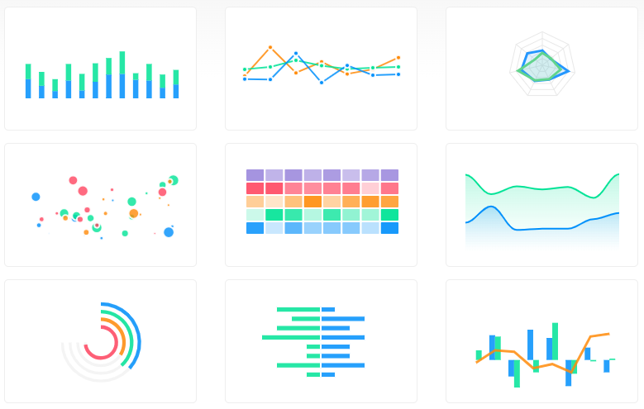
Exploring Data Chart & Graphs
ApexCharts.js
“Can you help me visualize this data in a chart?”
Simple Charts with ApexCharts.js
Quick Story
Asked ChatGPT for the top 5 open sources/free JavaScript chart libraries with specific features.
Provided it a use case and asked it to produce a simple web application with the ApexCharts.js.
It’s be a love affair ever since.
www.apexcharts.com

Slide 128
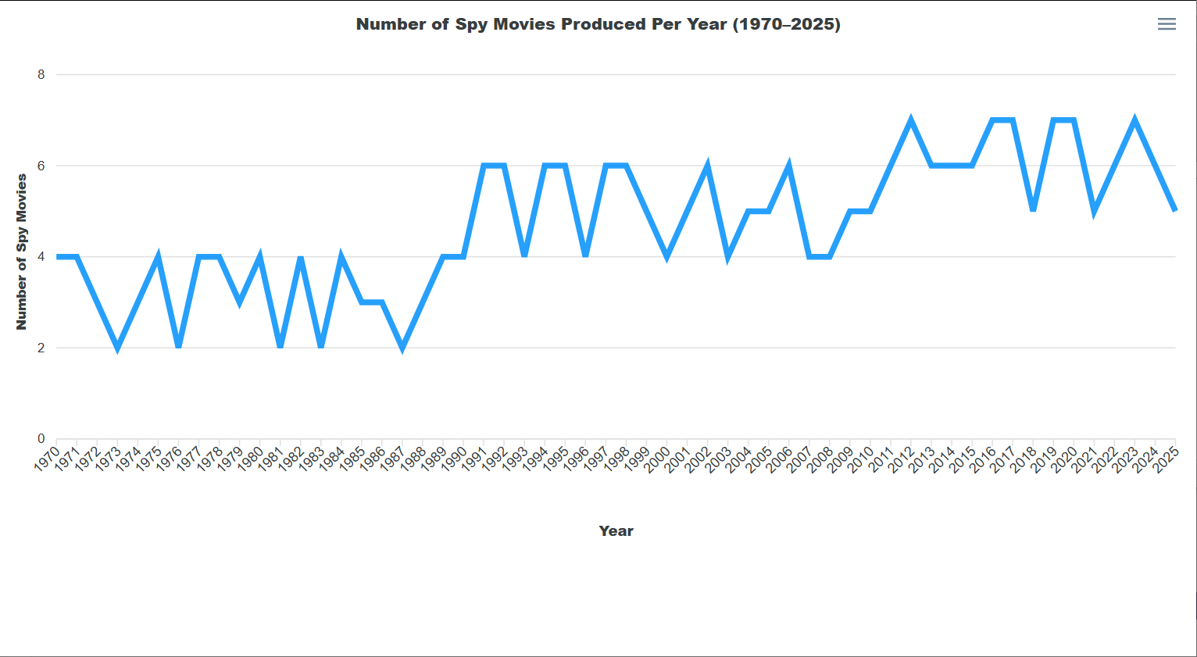
Exploring Data Chart & Graphs
Sample Prompt
Simple Charts with ApexCharts.js
Using ApexCharts.js, build me an html page that contains a timeline line chart that shows the number of spy movies produce per year between 1970 and 2025:
Has number of spy movies on the y axis.
Has year on the x axis.
Notes:
My primary point is that we can quickly use LLM to find the right tool for the jobs and generate simple prototype components.
At that point, I finally realized that doing research 100% manually is now officially doing it wrong.
Asking the right questions in the right way seems to be the way to go.
We’ve always done it any ways, but now instead of asking ourselves we can also ask our handy army of co-pilots. ☺

Slide 129
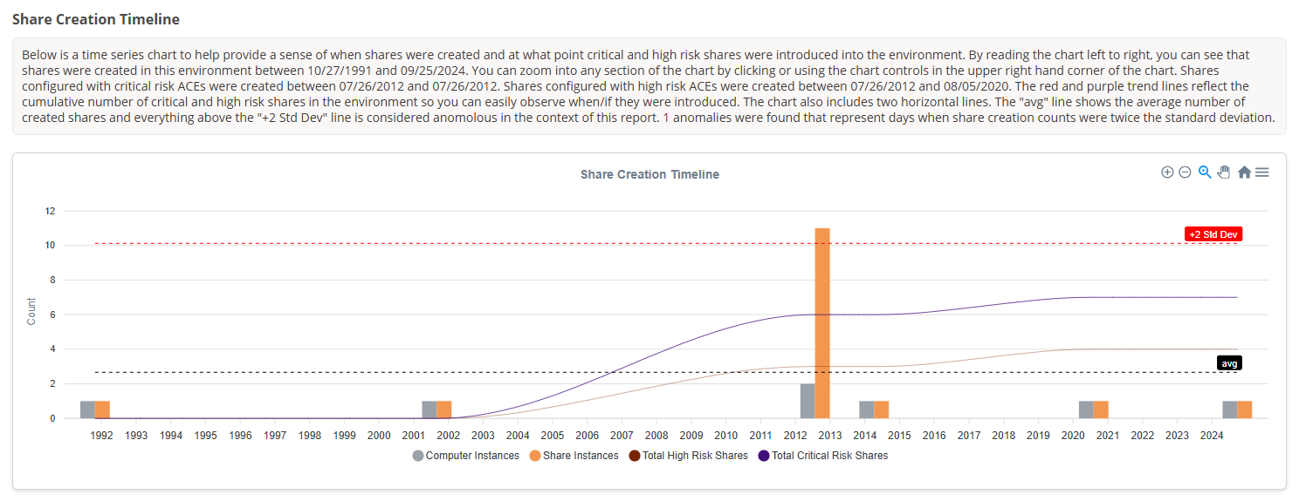
Exploring Data Chart & Graphs
Sample Prompt
Simple Charts with ApexCharts.js
Using ApexCharts.js, build me an html page that contains a timeline line chart that shows the number of spy movies produce per year between 1970 and 2025:
Has number of spy movies on the y axis.
Has year on the x axis.
Notes:
And with a little tweaking you can have it help you generate charts for things like Share Creation Timelines. ☺

Slide 130
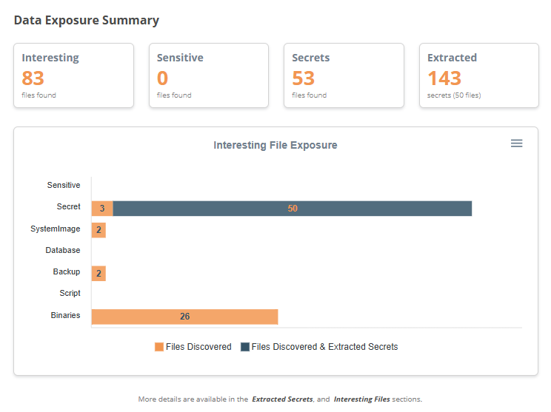
Exploring Data Chart & Graphs
Sample Prompt
Simple Charts with ApexCharts.js
Using ApexCharts.js, build me an html page that contains a timeline line chart that shows the number of spy movies produce per year between 1970 and 2025:
Has number of spy movies on the y axis.
Has year on the x axis.
Notes:
And with a little tweaking you can have it help you generate charts for things like Share Creation Timelines. ☺

Slide 131
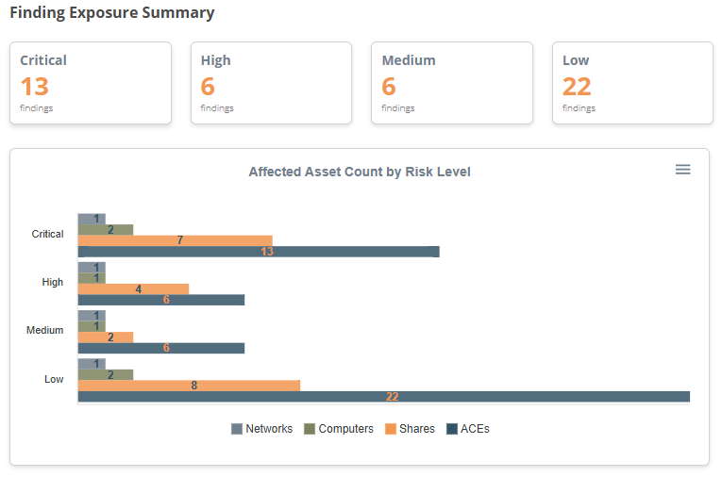
Exploring Data Chart & Graphs
Sample Prompt
Simple Charts with ApexCharts.js
Using ApexCharts.js, build me an html page that contains a timeline line chart that shows the number of spy movies produce per year between 1970 and 2025:
Has number of spy movies on the y axis.
Has year on the x axis.
Notes:
And with a little tweaking you can have it help you generate charts for things like Share Creation Timelines. ☺

Slide 132
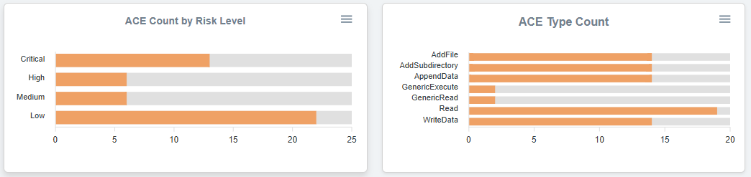
Exploring Data Chart & Graphs
Sample Prompt
Simple Charts with ApexCharts.js
Using ApexCharts.js, build me an html page that contains a timeline line chart that shows the number of spy movies produce per year between 1970 and 2025:
Has number of spy movies on the y axis.
Has year on the x axis.
Notes:
And with a little tweaking you can have it help you generate charts for things like Share Creation Timelines. ☺

Slide 133
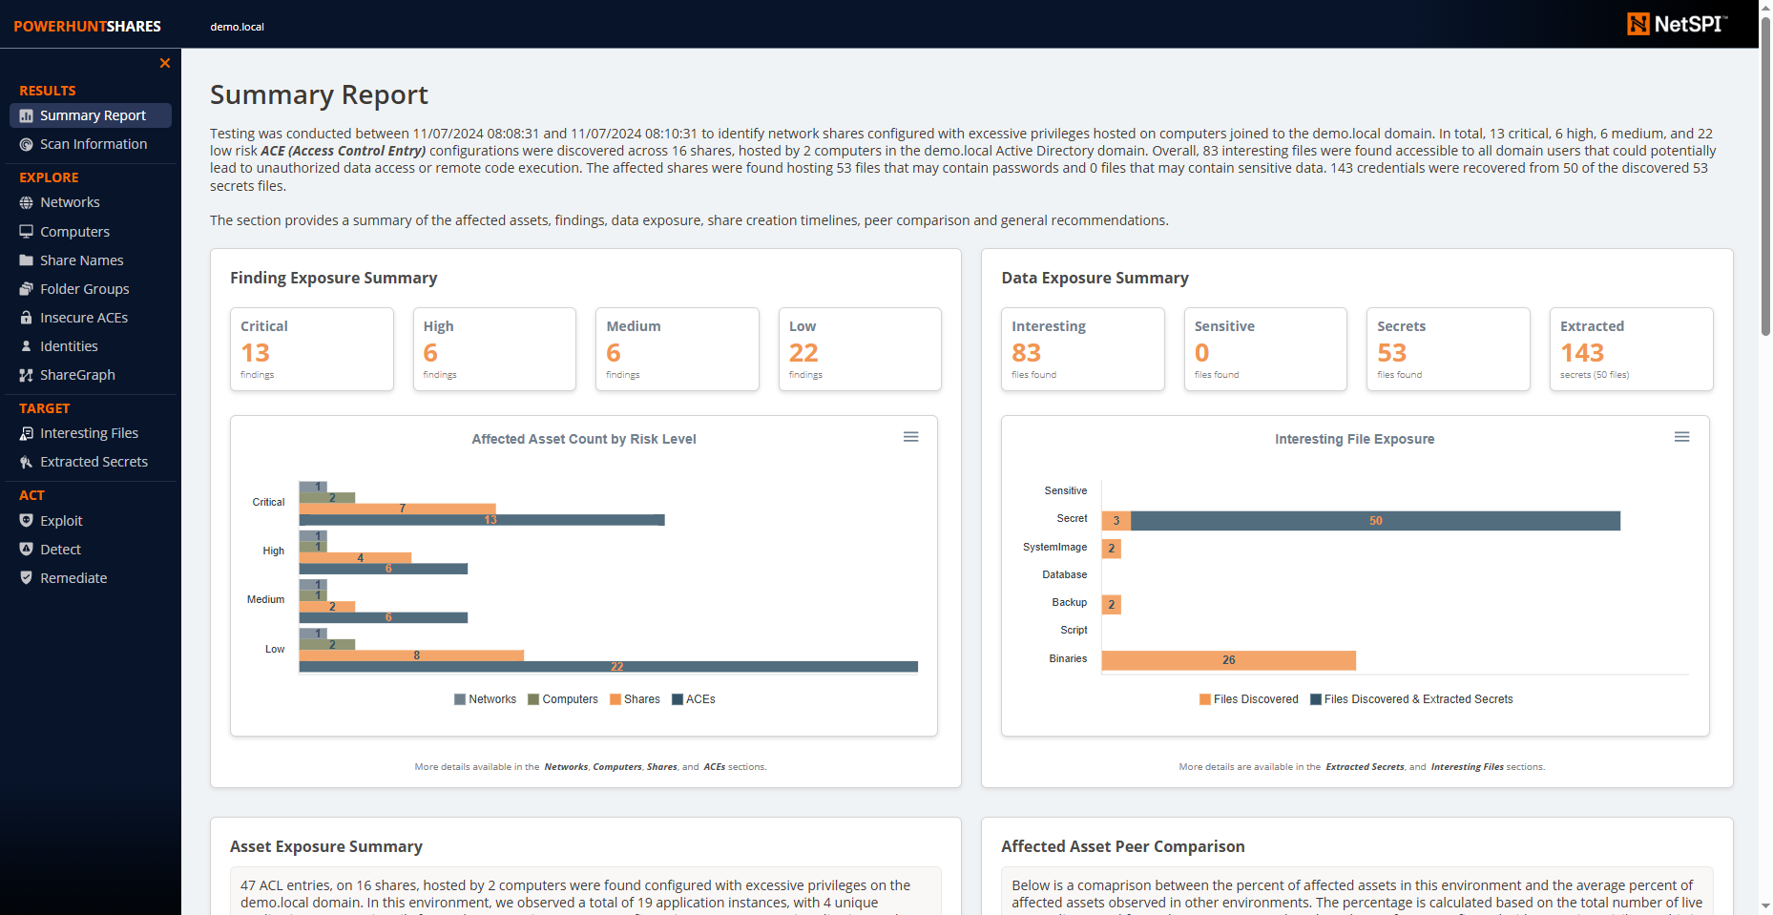
Exploring Data Chart & Graphs
Sample Prompt
Simple Charts with ApexCharts.js
Using ApexCharts.js, build me an html page that contains a timeline line chart that shows the number of spy movies produce per year between 1970 and 2025:
Has number of spy movies on the y axis.
Has year on the x axis.
Notes:
I use them in every section of the report output, here is a quick example.

Slide 134
Exploring Data Chart & Graphs
CytoScape.js
“Can you help me visualize these share relationships?”
Simple Charts with ApexCharts.js
Exploring Data with Graphs: Cytoscape.js
Similar Story
Asked ChatGPT for the top 5 open sources/free JavaScript graphing libraries with specific features
Provided it a use case and asked it to produce a simple web application with the graph using Cytoscape.js.
It’s be a love affair ever since.
js.cytoscape.org
Notes:
Generation
Graphs and Exploration

Slide 135
Exploring Data Chart & Graphs
CytoScape.js
“Can you help me visualize these share relationships?”
Simple Charts with ApexCharts.js
Exploring Data with Graphs: Cytoscape.js
Native Features
Generate Graph
Modify Graph Nodes & Layout
Search & Filter Graph
Algorithm support for things like shortest Path
Easy to customize styles
Easy to wrap code around
Notes:
Generation
Graphs and Exploration

Slide 136
Exploring Data Chart & Graphs
CytoScape.js
Prompt Example
Please create an html graph using Cytoscape.js that includes:
Layout Options
1. Add buttons to change the layout to breadthfirst and the top five other layouts like grid.
2. Add buttons to show Pageranked most influential nodes in bright orange.
3. When Pageranked button is clicked resize nodes based on pagerank.
3. Add buttons to show Betweenness Centrality nodes in bright tan and create a px border in black.
Nodes with the details below:
1. Four node types: ComputerName, ShareName, Owner, and User nodes.
2. Generate a list of 10 Owner nodes that look like user names.
3. Generate a list of 25 ComputerName nodes that look like they would be part of a common entrprise network.
4. Generate a list of 40 ShareName nodes that look like SMB shares used by applications
5. Generate a list of 5 UserName nodes that see like simple user names.
6. Ensure all nodes are large enough to be read.
7. Ensure all nodes are the same shape.
8. Ensure all nodes types have a different color.
Edges with the details below:
1. Four edge types: Owned_By, Hosted_By, Has_Write, and Has_Read.
2. Generate Owned_By edges between Owner nodes and ShareName nodes. Ensure each ShareName has one owner.
3. Generate Hosted_By edges between ShareName nodes and ComputerName nodes. Assign those Hosted_By edges randomly, but ensure at least 80% of ComputerName nodes have at least one ShareName node connected.
4. Generate 20 Has_Write edge between randomaly selected UserName nodes and ShareNames. Do not allow the same UserName to link to a ShareName node more than once using a Has_Write edge.
5. Generate 30 Has_Read edge between randomaly selected UserName nodes and ShareNames. Do not allow the same UserName to link to a ShareName node more than once using a Has_Read edge.
6. Ensure all nodes are large enough to be read.
7. Ensure all nodes are the same shape.
Please dont forget to add the nodes and edges.
Simple Charts with ApexCharts.js
Exploring Data with Graphs: Cytoscape.js
Notes:
I started by just experimenting with prompts.

Slide 137
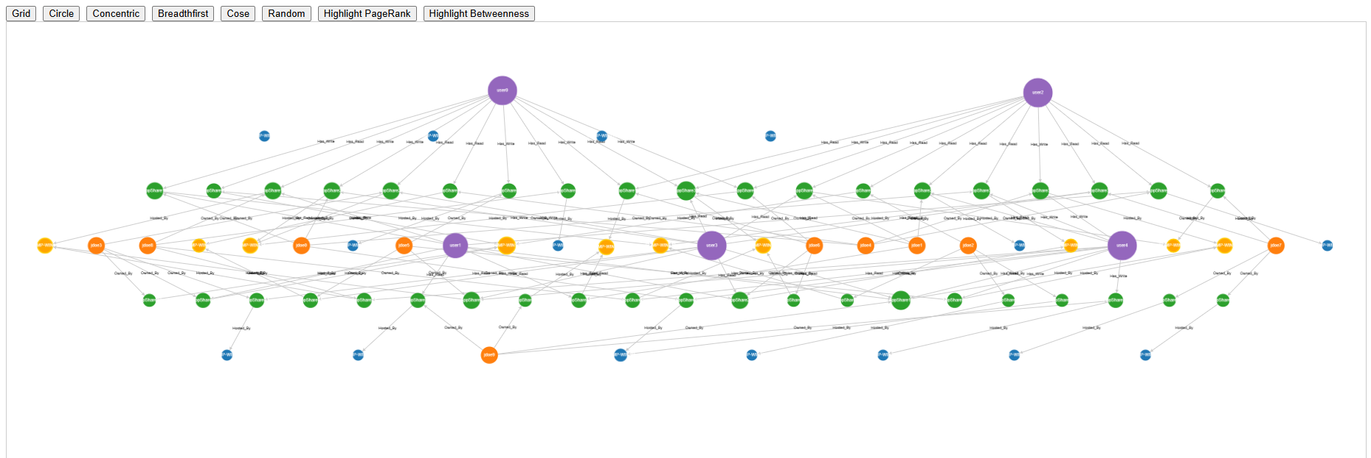
Exploring Data Chart & Graphs
CytoScape.js
Prompt Example
Data can be fun:
Simple Charts with ApexCharts.js
Simple Graphing with Cytoscape.js
Please create an html graph using Cytoscape.js that includes:
Layout Options
1. Add buttons to change the layout to breadthfirst and the top five other layouts like grid.
2. Add buttons to show Pageranked most influential nodes in bright orange.
3. When Pageranked button is clicked resize nodes based on pagerank.
3. Add buttons to show Betweenness Centrality nodes in bright tan and create a px border in black.
Nodes with the details below:
1. Four node types: ComputerName, ShareName, Owner, and User nodes.
2. Generate a list of 10 Owner nodes that look like user names.
3. Generate a list of 25 ComputerName nodes that look like they would be part of a common entrprise network.
4. Generate a list of 40 ShareName nodes that look like SMB shares used by applications
5. Generate a list of 5 UserName nodes that see like simple user names.
6. Ensure all nodes are large enough to be read.
7. Ensure all nodes are the same shape.
8. Ensure all nodes types have a different color.
Edges with the details below:
1. Four edge types: Owned_By, Hosted_By, Has_Write, and Has_Read.
2. Generate Owned_By edges between Owner nodes and ShareName nodes. Ensure each ShareName has one owner.
3. Generate Hosted_By edges between ShareName nodes and ComputerName nodes. Assign those Hosted_By edges randomly, but ensure at least 80% of ComputerName nodes have at least one ShareName node connected.
4. Generate 20 Has_Write edge between randomaly selected UserName nodes and ShareNames. Do not allow the same UserName to link to a ShareName node more than once using a Has_Write edge.
5. Generate 30 Has_Read edge between randomaly selected UserName nodes and ShareNames. Do not allow the same UserName to link to a ShareName node more than once using a Has_Read edge.
6. Ensure all nodes are large enough to be read.
7. Ensure all nodes are the same shape.
Please dont forget to add the nodes and edges.
Notes:
Which has half decent results.
You can provide real data sets, and it will graph them for you nicely with a little direction.

Slide 138
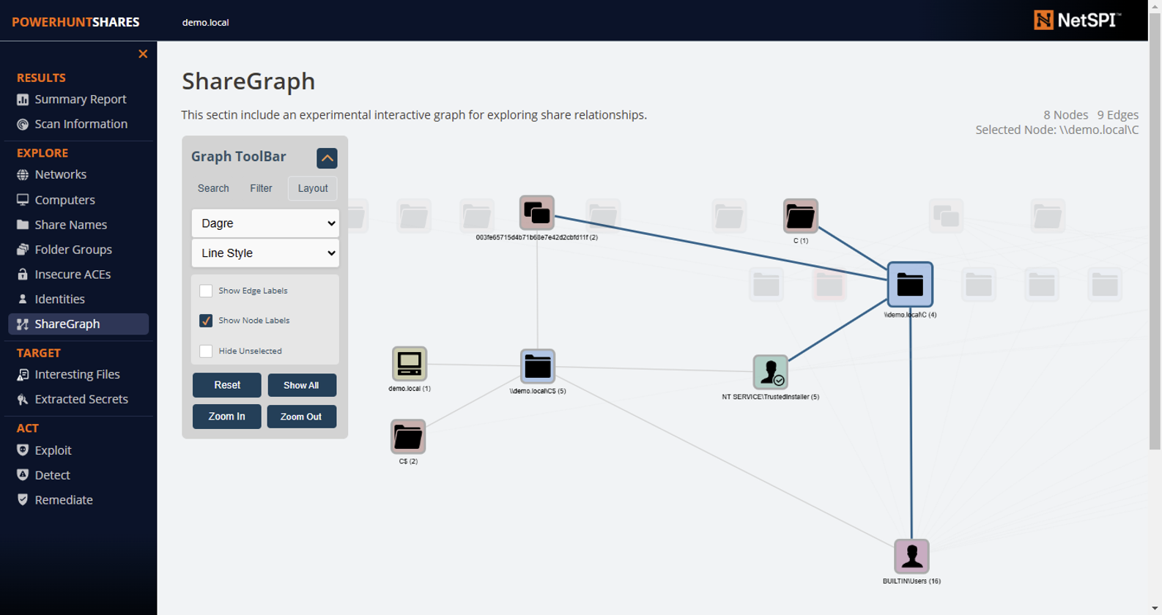
Charts, Graphs & Algorithms
Summary
Data can be fun:
Simple Charts with ApexCharts.js
Simple Graphing with Cytoscape.js
“Can you help me visualize some of these share relationships?”
Easy to:
Search
Shortest Path
Save Image
Filter Graph
Change Layouts using fun Algorithms
Make interactive
Notes:
From there I was able to quickly branch out to the functionality I have added to PowerHuntShares v2.
Not design to be a attack path graph.
Intended for share exploration and for story telling.
-- Explore paths
Explore data and relationships
Link through share names, folder hashes, owners, to find interesting things.
Filter and sort layout to tell stories
PowerShell -> Array Data Set -> JavaScript with styles and actions.

Slide 139
Charts, Graphs & Algorithms
Summary
Not designed to be an attack path graphing tool.
Intended for share exploration and story telling.
Data can be fun:
Simple Charts with ApexCharts.js
Simple Graphing with Cytoscape.js
“Can you help me visualize some of these share relationships?”
Easy to:
Search
Shortest Path
Save Image
Filter Graph
Change Layouts using fun Algorithms
Make interactive
Notes:
From there I was able to quickly branch out to the functionality I have added to PowerHuntShares v2.
Not design to be a attack path graph.
Intended for share exploration and for story telling.
-- Explore paths
Explore data and relationships
Link through share names, folder hashes, owners, to find interesting things.
Filter and sort layout to tell stories
PowerShell -> Array Data Set -> JavaScript with styles and actions.

Slide 140
Finding Nodes That Matter
Finding Nodes that Matter
“Are there things I’m not thinking of and what other tools are available?”
Explored Neo4j Graph Data Science (GDS) library
https://neo4j.com/docs/graph-data-science/current/algorithms/
30 algorithms reviewed
I was looking for problems for these solutions ;)
Algorithms I liked in Neo4j
Page Rank - What nodes have the most influence?
Betweenness Centrality - What nodes act as a bridge?
Louvain - What are natural node clusters?
All of the algorithms I liked were also available in Cytoscape.js ☺
Notes:
Page rank, betweenness, other algorithms

Slide 141
Finding Nodes That Matter
Page Rank
“What are the most Influential Nodes?”
Finding Nodes that Matter: PageRank
Supported by Cytoscape.js and Neo4j
Why Should I Care?
Offense can identify which nodes will provide access to resources, routes, etc.
Defense can do the same and add preventative, detective and corrective controls to make them more resilient to attack
Simple Example
When experimenting with simple Active Directory environment graphs, Page Rank could be used to identify the most influential nodes… guess which node do you think was most influential?
Notes:
https://neo4j.com/blog/graph-data-science/graph-algorithms-neo4j-pagerank/
What are the most influential nodes and why?
Node that have a lot of followers, but don’t follow many have higher ranking, and the pass on some of that weight to people they follow.
Owners mostly. But owners can tell us something about how the share was created, trusted installer, administrator, nt service, nt system, etc. Can reflect person or process

Slide 142
Finding Nodes That Matter
Page Rank
“What are the most Influential Nodes?”
Finding Nodes that Matter: PageRank
Supported by Cytoscape.js and Neo4j
Why Should I Care?
Offense can identify which nodes will provide access to resources, routes, etc.
Defense can do the same and add preventative, detective and corrective controls to make them more resilient to attack
Simple Example
When experimenting with simple Active Directory environment graphs, Page Rank could be used to identify the most influential nodes… guess which node do you think was most influential?
Domain
Notes:
https://neo4j.com/blog/graph-data-science/graph-algorithms-neo4j-pagerank/
What are the most influential nodes and why?
Node that have a lot of followers, but don’t follow many have higher ranking, and the pass on some of that weight to people they follow.
Owners mostly. But owners can tell us something about how the share was created, trusted installer, administrator, nt service, nt system, etc. Can reflect person or process

Slide 143
Finding Nodes That Matter
Page Rank
“What are the most Influential Nodes?”
Finding Nodes that Matter: PageRank
Supported by Cytoscape.js and Neo4j
38
34
2
10
5
2
2
2
2
2
Notes:
https://neo4j.com/blog/graph-data-science/graph-algorithms-neo4j-pagerank/
What are the most influential nodes and why?
Node that have a lot of followers, but don’t follow many have higher ranking, and the pass on some of that weight to people they follow.
Owners mostly. But owners can tell us something about how the share was created, trusted installer, administrator, nt service, nt system, etc. Can reflect person or process

Slide 144
Finding Nodes That Matter
Page Rank
Who are the most Influential Nodes?
Cytoscape supports this.
Finding Nodes that Matter: PageRank
Supported by Cytoscape.js and Neo4j
38
34
2
10
5
2
2
2
2
2
Notes:
https://neo4j.com/blog/graph-data-science/graph-algorithms-neo4j-pagerank/
What are the most influential nodes and why?
Node that have a lot of followers, but don’t follow many have higher ranking, and the pass on some of that weight to people they follow.
Owners mostly. But owners can tell us something about how the share was created, trusted installer, administrator, nt service, nt system, etc. Can reflect person or process

Slide 145
Finding Nodes That Matter
Page Rank
Page Rank
Who are the most Influential Nodes?
Cytoscape supports this.
Data can be fun:
Simple Charts with ApexCharts.js
Simple Graphing with Cytoscape.js
Finding Nodes that Matter: Neo4j GDS
38
34
2
10
5
2
2
2
2
2
Notes:
https://neo4j.com/blog/graph-data-science/graph-algorithms-neo4j-pagerank/
What are the most influential nodes and why?
Node that have a lot of followers, but don’t follow many have higher ranking, and the pass on some of that weight to people they follow.
Owners mostly. But owners can tell us something about how the share was created, trusted installer, administrator, nt service, nt system, etc. Can reflect person or process

Slide 146
Finding Nodes That Matter
Betweenness Centrality
Finding Nodes that Matter: PageRank
Finding Nodes that Matter: Betweenness
"Which nodes lie on the shortest paths between other nodes?“ aka they act like bridges between communities of nodes.
Supported by Cytoscape.js and Neo4j
Why Should I Care?
We may be able to determine which nodes are providing attackers with the greatest mobility.
Prioritizing their remediation may help reduce risk or the speed at which attackers can move.
A
D
C
F
G
B
E
Notes:
https://neo4j.com/docs/graph-data-science/current/algorithms/betweenness-centrality/
Any shortest path from A or B to D, E, F, or G has to pass through C.
Reduce paths to high value targets.

Slide 147
Finding Nodes That Matter
Betweenness Centrality
Finding Nodes that Matter: PageRank
Finding Nodes that Matter: Betweenness
"Which nodes lie on the shortest paths between other nodes?“ aka they act like bridges between communities of nodes.
Supported by Cytoscape.js and Neo4j
Why Should I Care?
We may be able to determine which nodes are providing attackers with the greatest mobility.
Prioritizing their remediation may help reduce risk or the speed at which attackers can move.
A
D
C
F
G
B
E
Notes:
https://neo4j.com/docs/graph-data-science/current/algorithms/betweenness-centrality/
Any shortest path from A or B to D, E, F, or G has to pass through C.

Slide 148
Finding Nodes That Matter
Betweenness Centrality
Telling Stories with Charts: ApexCharts.js
Exploring Data with Graphs: Cytoscape.js
Finding Nodes that Matter: PageRank
Finding Nodes that Matter: Betweenness
"Which nodes lie on the shortest paths between other nodes?“ aka they act like bridges between communities of nodes.
Why Should I Care?
We may be able to determine which nodes are providing attackers with the greatest mobility.
Prioritizing their remediation may help reduce risk or the speed at which attackers can move.
Supported by Cytoscape.js and Neo4j
A
D
C
F
G
B
E
Notes:
https://neo4j.com/docs/graph-data-science/current/algorithms/betweenness-centrality/
Any shortest path from A or B to D, E, F, or G has to pass through C.

Slide 149
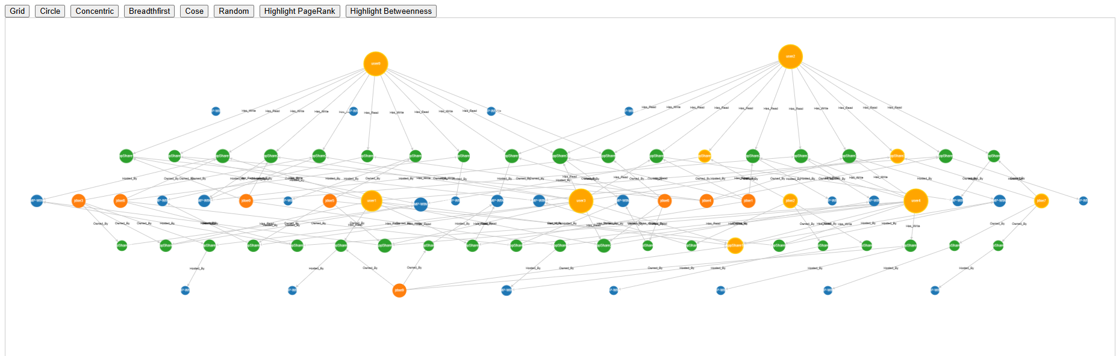
Finding Nodes That Matter
Betweenness Centrality
Telling Stories with Charts: ApexCharts.js
Exploring Data with Graphs: Cytoscape.js
Finding Nodes that Matter: PageRank
Finding Nodes that Matter: Betweenness
"Which nodes lie on the shortest paths between other nodes?“ aka they act like bridges between communities of nodes.
Why Should I Care?
We may be able to determine which nodes are providing attackers with the greatest mobility.
Prioritizing their remediation may help reduce risk or the speed at which attackers can move.
Supported by Cytoscape.js and Neo4j
A
D
C
F
G
B
E
Notes:
https://neo4j.com/docs/graph-data-science/current/algorithms/betweenness-centrality/
Any shortest path from A or B to D, E, F, or G has to pass through C.

Slide 150

PowerHuntShares Process
Define
Goals
Collect
Data
Clean
Data
Transform
Data
Analyze
Data
Extract Insights & Predictions
Conclusions, Findings
& Recommendations
Take
Actions
Conclusions, Findings, & Recommendations
How many shares are vulnerable?
What shares are most vulnerable?
When were the shares created?
What application will be affected if we fix this?
How can I remediate shares efficiently?
How they should and do compare to peers?
https://github.com/NetSPI/PowerHuntShares

Slide 151

PowerHuntShares Process
Define
Goals
Collect
Data
Clean
Data
Transform
Data
Analyze
Data
Extract Insights & Predictions
Conclusions, Findings
& Recommendations
Take
Actions
Take Actions
Exploit
Remediate
Detect
https://github.com/NetSPI/PowerHuntShares

Slide 152
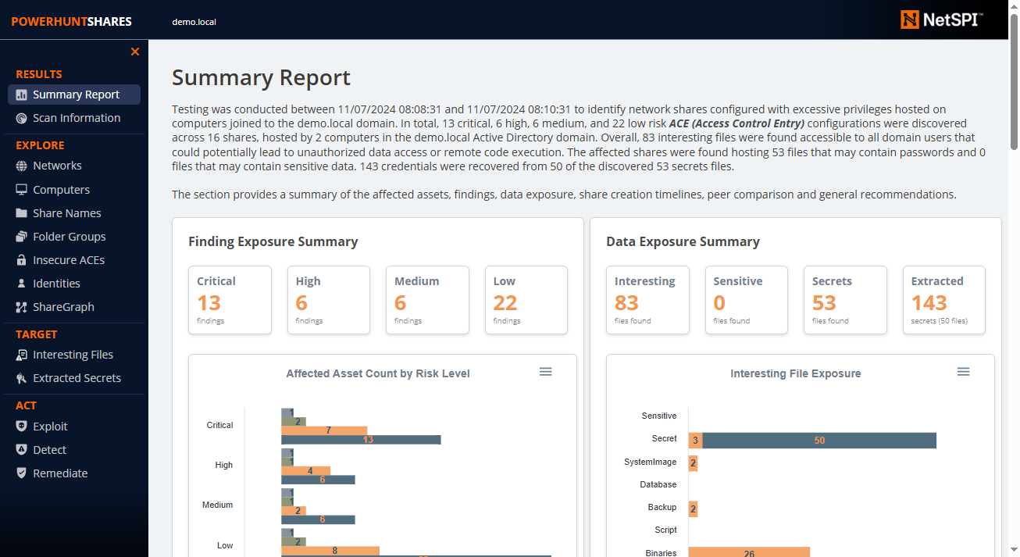
PowerHuntShares Demo

Slide 153
Take Aways

Slide 154






Take Aways
Play with your data!
Use data analysis tools to help improve your quality of life as a defender or tester.
Not all solutions require LLMs, but they can help save time!
PowerHuntShares can be another tool in the box
Notes:
Most administrator don’t know every share in their environment.

Slide 155
Thank you
Good luck and hack responsibly.
Scott Sutherland BlueSky: @nullbind.bsky.social x: @_nullbind GitHub: nullbind

